Slide 1

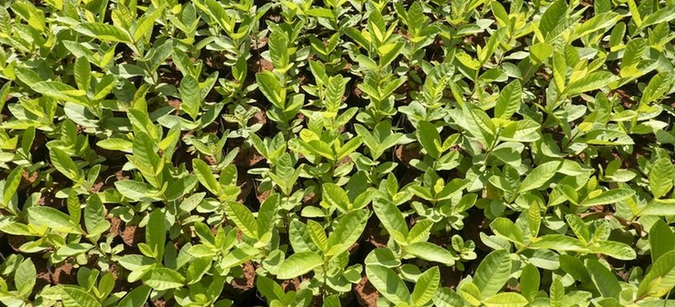

Save Soil
Photo: Save Soil (Isha Foundation)
A coconut farm went from 0.86% to 2.33% organic matter
Valluvan's farm in Tamil Nadu, India.
Full case study: link in bio

Slide 2

140
coconuts per tree, up from 90 to 100
Nothing changed for the first three years.
Tamil Nadu, India

Slide 3
Under 10%
of what he used to spend on fertiliser
Workers: 1, down from 10 to 20.
Tamil Nadu, India

Slide 4
1,200 mm
of rain in a few days, in 2018
It came after two years of drought.
Tamil Nadu, India

Slide 5
6 to 7 feet
more water in his wells
His neighbours' open wells stood 6 to 7 feet lower than his.
Tamil Nadu, India

Slide 6
What he did
Dug trenches between the rows and filled them with leaf litter
Mulched around every crop
Planted layered crops
Stopped burning and summer ploughing
Link in bio

