Slide 1




SMALL BUSINESS SATURDAY
Colleen
Dempster
Rewild Soils, Uxbridge, Ontario

Slide 2

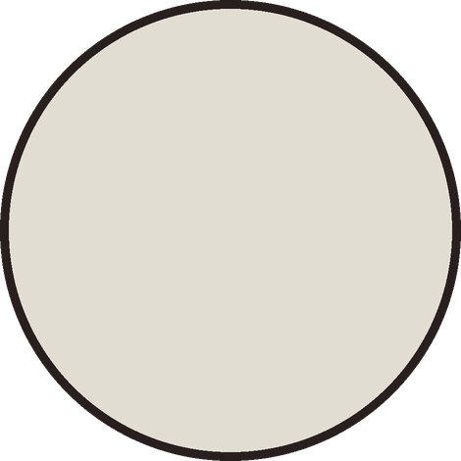
“
Most people have never seen the microbes that make up the soil food web, so I show pictures and do live microscope demonstrations
Colleen Dempster
PHOTO: one of
Colleen’s own
micrographs

Slide 3



Colleen’s path
2022
started Rewild Soils
Since then
analysed more than 300 soil and compost samples, re-certified as a Soil Food Web lab every year
Now
finishing the last steps to become a Soil Food Web Consultant

Slide 4

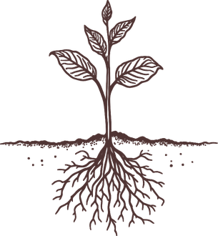
“
Making compost and exploring samples under the microscope will always be something I enjoy
Colleen believes rewilding soils with microbes is about restoring systems and people’s connection with the Earth

Slide 5





Find a Soil Food Web
consultant or lab
near you
Link in bio
WITH THANKS TO COLLEEN DEMPSTER
rewildsoils.com

