Slide 1


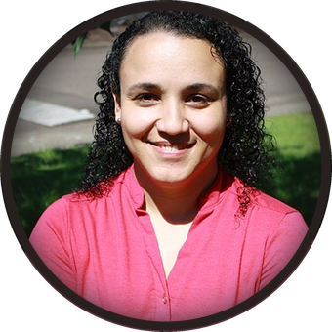

Tomorrow, live · Carla Portugal
Restoring the soil food web to grow nutrition your patients need
The plant’s “gut microbiome”
Crop antioxidants, vitamins, and minerals
What the peer-reviewed evidence
does (and doesn’t) support
Live polling, hands-on checklist
practice, and real-time Q&A
Sunday 15 November, 7 to 7:45am Pacific
Food as Medicine for All · Livestream

