Slide 1



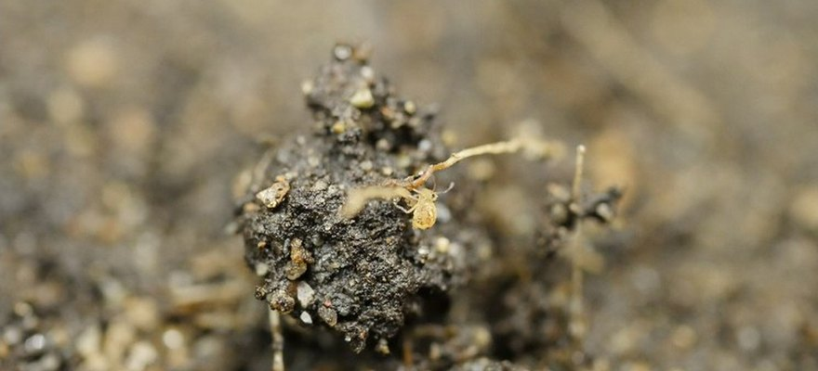


Save Soil
Springtail. Photo: Lewis Fausak, CC BY-SA 4.0
Soil may be home to 59% of all life on Earth
Anthony et al., PNAS 2023, via Save Soil.
Read More
Source:
consciousplanet.org/save-soil

