Slide 1



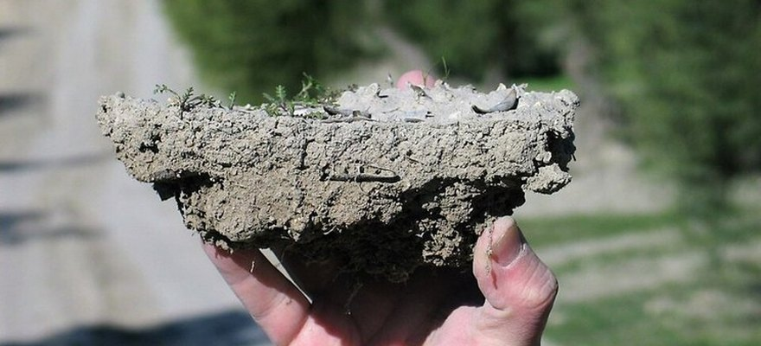


Save Soil
Photo: Antonio Jordán, CC BY-SA 3.0
Healthy soil cools the land
From Save Soil's report "The Soil Carbon Sponge".
Read More
Source:
consciousplanet.org/save-soil

Slide 2


Water carries heat away
Water in soil evaporates through plants and cools the land.

Slide 3

Bare soil heats the air
Degraded soil can't hold that water, so the sun heats the air instead.

Slide 4


Cover the ground
Cover crops and mulch keep the ground from baking.

Slide 5

Fungi hold the pores open
Fungal threads and bacterial glues keep the sponge's pores open.

Slide 6

Read the article
From Save Soil (Isha Foundation). Link in bio.

