Slide 1



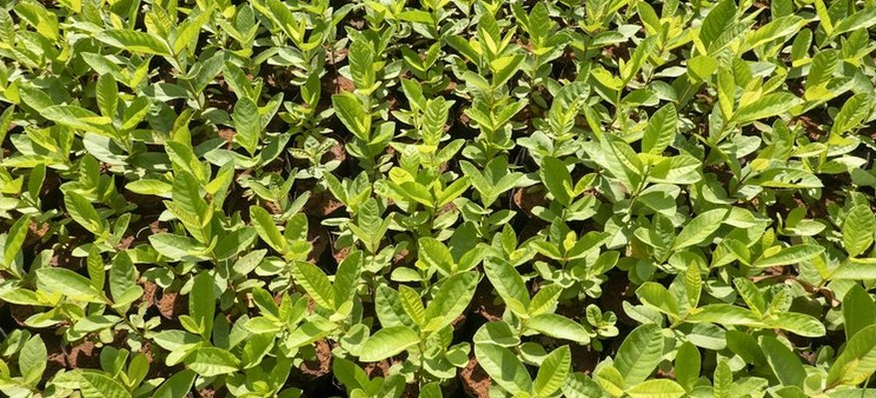


Save Soil
Photo: Save Soil (Isha Foundation)
A coconut farm: 0.86% to 2.33% organic matter
Save Soil's case study of Valluvan's farm in Tamil Nadu.
Read More
Source:
consciousplanet.org/save-soil

Slide 2


90-100 coconuts per tree, now 140
Nothing changed in the first three years.

Slide 3

Fertiliser: under 10%
Of what he used to spend. Workers: 1, down from 10 to 20.

Slide 4


1,200 mm of rain in days
2018, after two years of drought.

Slide 5

Wells 6 to 7 feet higher
His neighbours' open wells stood 6 to 7 feet lower than his.

Slide 6


What he did
Leaf litter trenches between rows, mulch, layered crops, no burning, no summer ploughing.

Slide 7


Read the article
From Save Soil (Isha Foundation). Link in bio.

