Slide 1



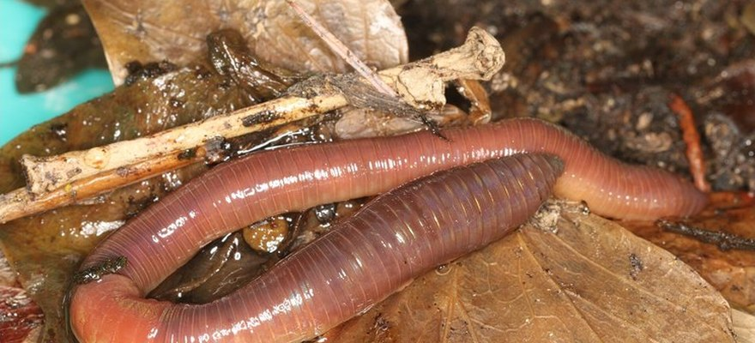


Save Soil
Photo: Donald Hobern, CC BY 2.0
5 numbers that show what soil life does
From Save Soil's paper on soil and adaptation.
Read More
Source:
consciousplanet.org/save-soil

Slide 2


6x faster
Water soaked into regenerative almond orchards 6 times faster. LaCanne et al. 2021

Slide 3


133% more microbial carbon
In regenerative organic soils. Mäder et al. 2025

Slide 4

2.4 to 13.5x more earthworms
In diversified rotations than in rye monoculture. Bogušas et al. 2022

Slide 5

+24% glomalin
The fungal protein that glues soil crumbs together, under perennial pasture. Abán et al. 2025

Slide 6

+38 to 137% maize yield
In drought years, in legume and manure systems. Lotter et al. 2003

Slide 7


Read the article
From Save Soil (Isha Foundation). Link in bio.

