Slide 1



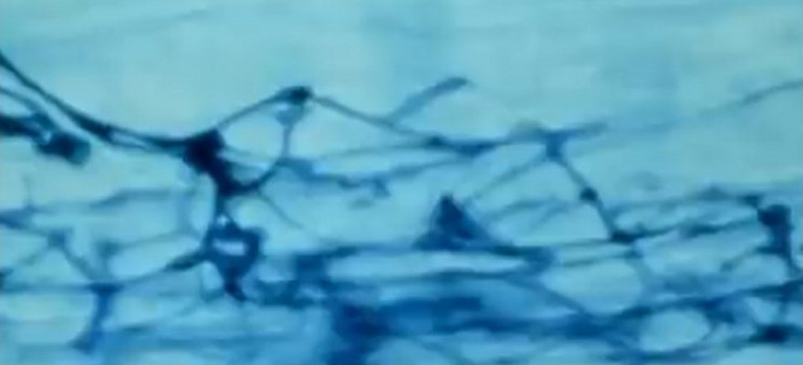


Save Soil
Photo: Marc-André Selosse, CC0
Your soil shapes your gut more than your genes
From Save Soil's paper on soil and human health.
Read More
Source:
consciousplanet.org/save-soil

Slide 2


Baboons: soil beat genes 15x
The soil around them shaped their gut microbes 15 times more strongly than their genetics.

Slide 3

Under 8% inherited
Less than 8% of the human gut microbiome is inherited. Rothschild et al. 2018

Slide 4

Fungi carry minerals in
Mycorrhizal fungi carry copper, iron, nitrogen, phosphorus and zinc into crops.

Slide 5

Rhizobia make plant food
Bacteria in legume roots turn nitrogen from the air into plant food.

Slide 6


Read the article
From Save Soil (Isha Foundation). Link in bio.

