Slide 1


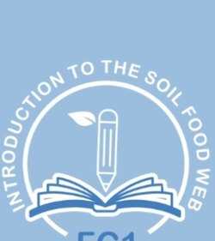
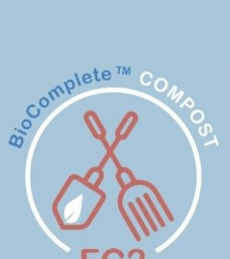
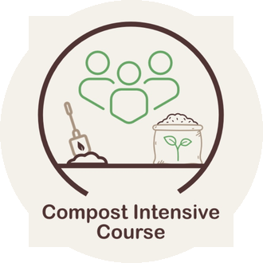
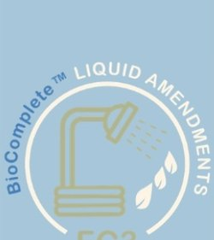


+
Foundation Courses + Compost Intensive
Fall Enrollment Special, until 2 December. Link in bio.

Slide 2


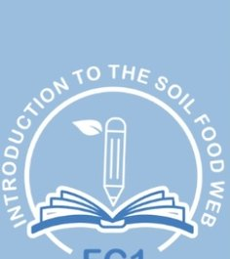

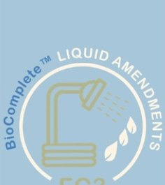


The Foundation Courses teach you to work out what your soil needs.
Introduction to the Soil Food Web, BioComplete™ Compost, BioComplete™ Liquid Amendments and Microscopy. Self-paced, start the day you enroll.

Slide 3

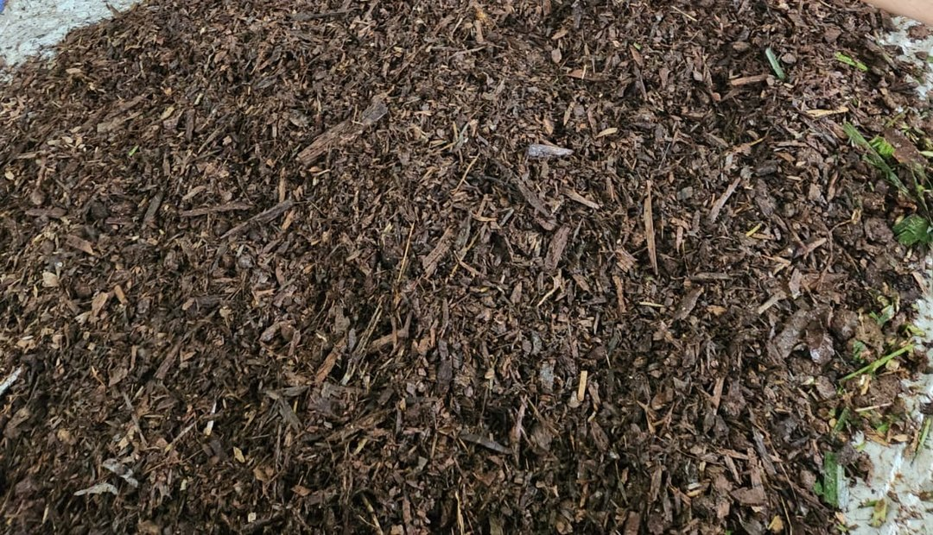
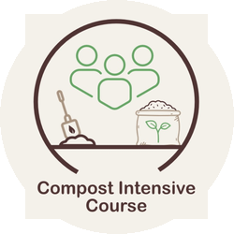
The Compost Intensive Course teaches you to make it.
Ten weeks online, with a 90-minute live session with a mentor every week. You build two batches of compost where you live, and you keep them.

