Slide 1


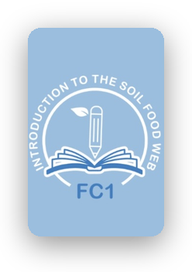
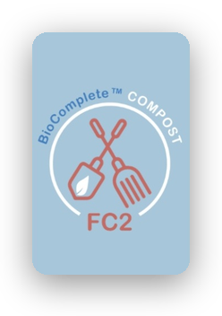
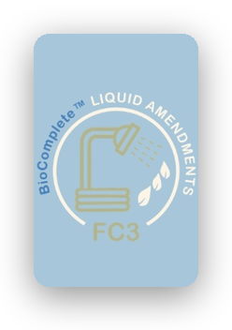
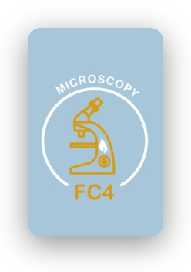

Foundation Courses + Compost Intensive
Fall Enrollment Special, until 2 December.

Slide 2


The Foundation Courses teach you to work out what your soil needs.
Introduction to the Soil Food Web, BioComplete™ Compost, BioComplete™ Liquid Amendments and Microscopy. Self-paced, start the day you enroll.

Slide 3


The Compost Intensive Course teaches you to make it.
Ten weeks online, with a 90-minute live session with a mentor every week.
You build two compost piles right where you live.

Slide 4


Choose your cohort
January, May or August 2027.
Fall Enrollment Special, until 2 December.
Link in bio.

