Slide 1




Happy Small
Business Saturday
Meet Colleen Dempster
of Rewild Soils

Slide 2

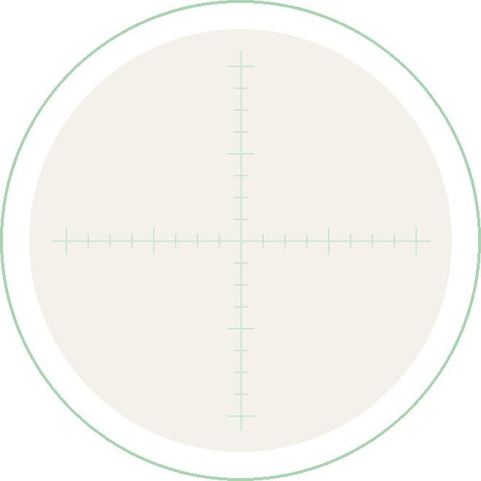

A Soil Food Web
certified lab since
2022
Re-certified every year, with
more than 300 microbial reports

Slide 3

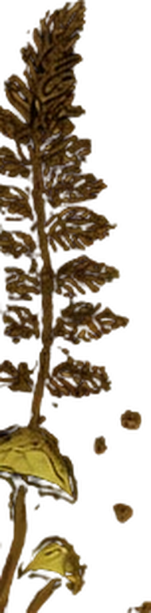

“
Most people have never
seen the microbes that
make up the soil food web,
so I show pictures and do
live microscope
demonstrations
Colleen Dempster

Slide 4

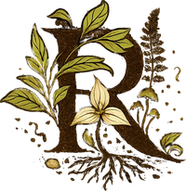
What Rewild Soils offers
Microbial analysis reports
Compost, compost teas
and extracts
Compost tea brew kits
Consulting and soil
health testing
Workshops and talks
Hiwassee 100X
Extractor rental

Slide 5

“
Making compost and exploring
samples under the microscope
will always be something
I enjoy
Colleen is in the final stages of the
Soil Food Web Consultant Program

Slide 6


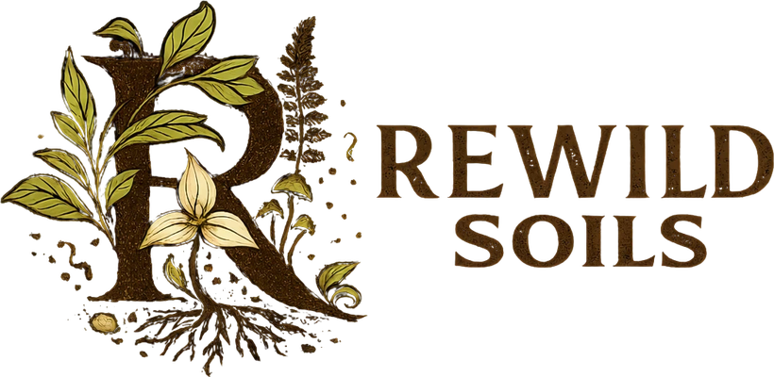

Soil microscopy, consulting,
workshops and compost
from Uxbridge, Ontario
rewildsoils.com

