Slide 1
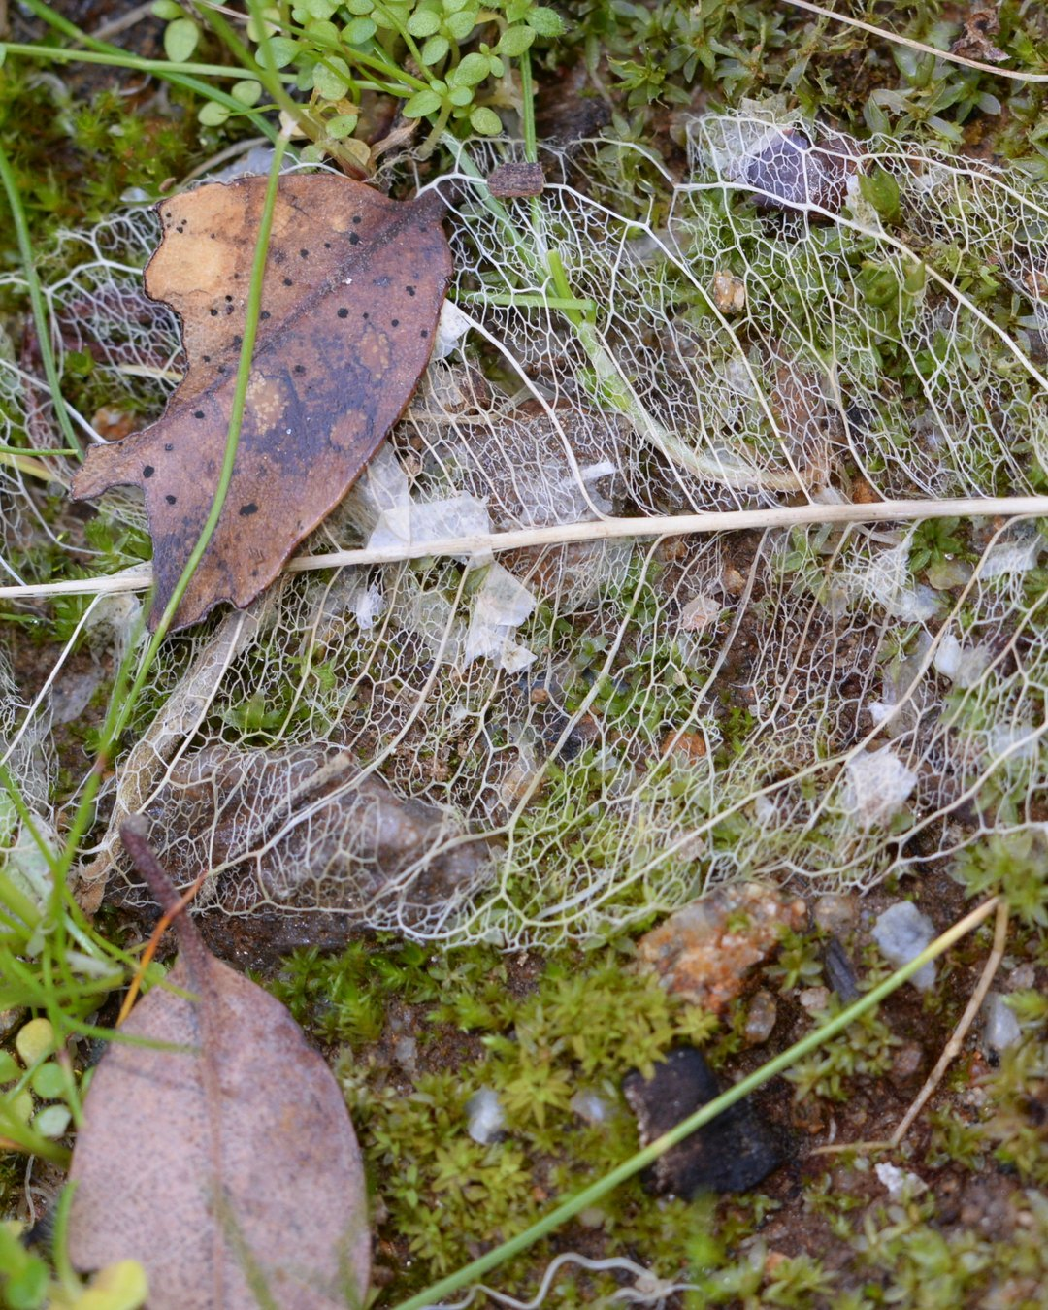



Fall leaves are free food for your soil.
Photo: Jim Whitehead, CC BY 2.0

Slide 2
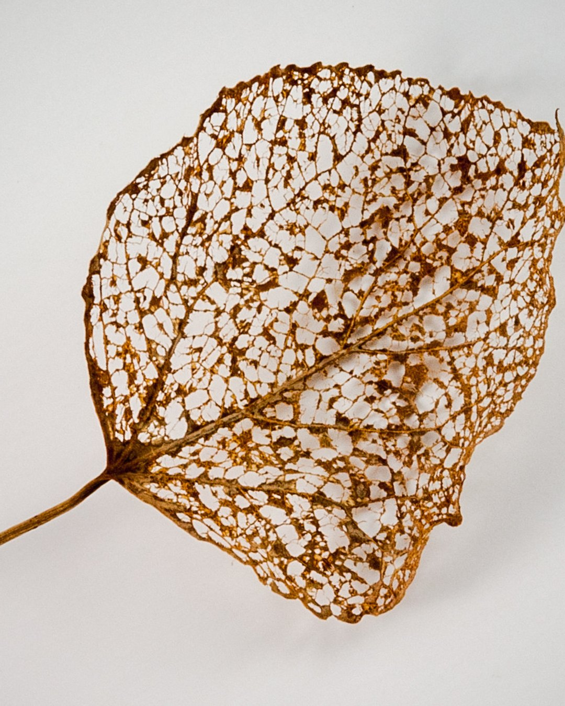

Leaf litter is high in carbon, cellulose and lignin.
Photo: Paul VanDerWerf, CC BY 2.0

Slide 3

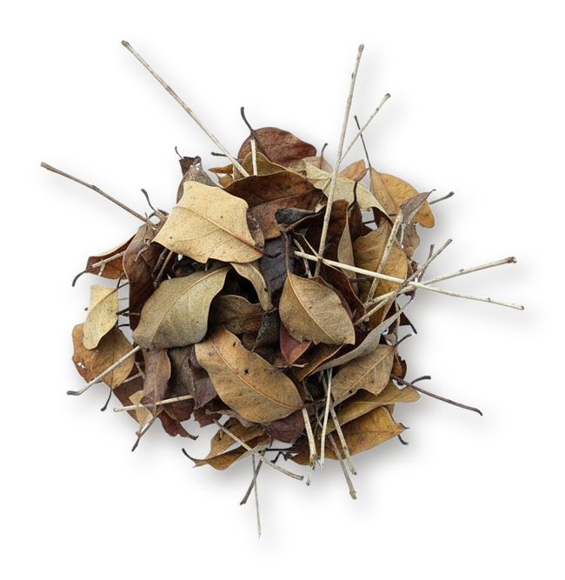
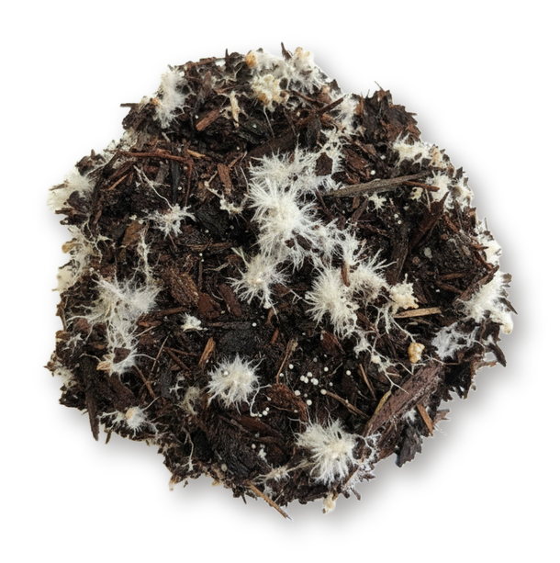

Saprotrophic fungi are the main decomposers of lignin. Leaf litter feeds fungal biomass.

Slide 4

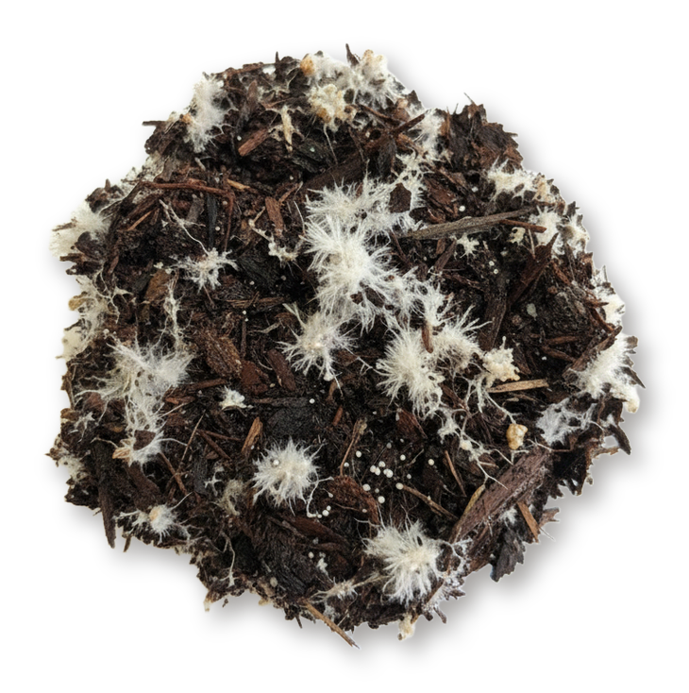
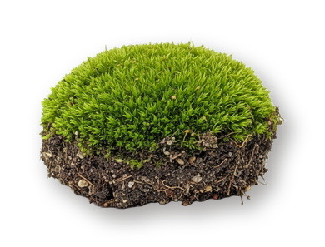

That pushes the fungal to bacterial ratio toward fungal dominance, which perennials, shrubs and trees prefer.

Slide 5
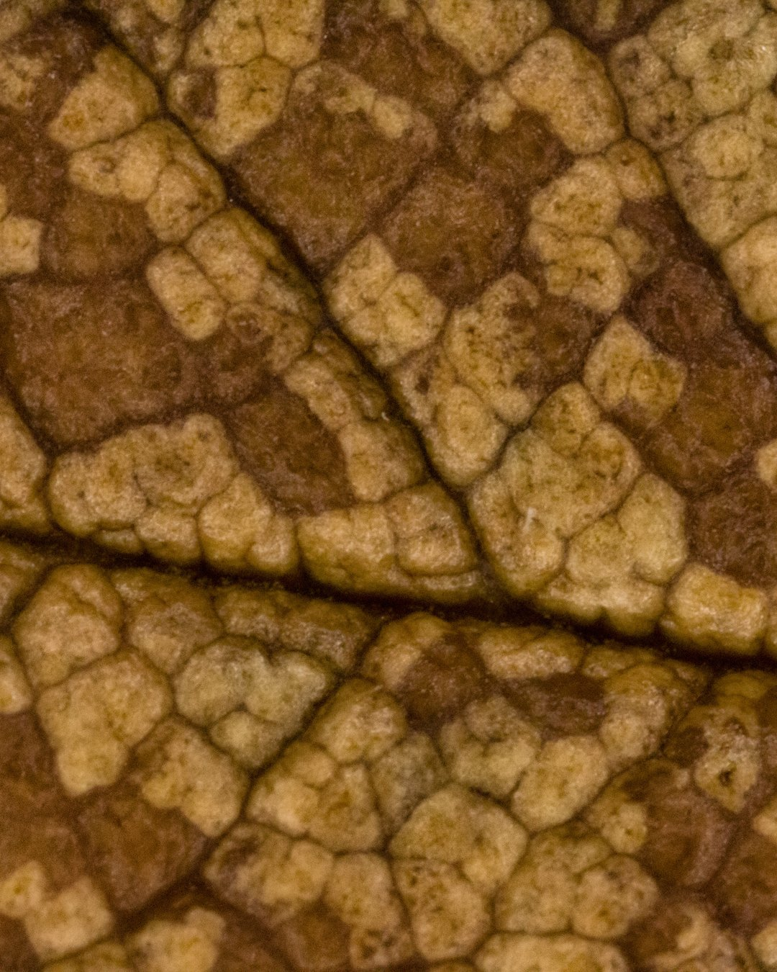

A litter layer shields soil aggregates from raindrop impact over winter.
Photo: David Lee, CC BY 2.0

Slide 6
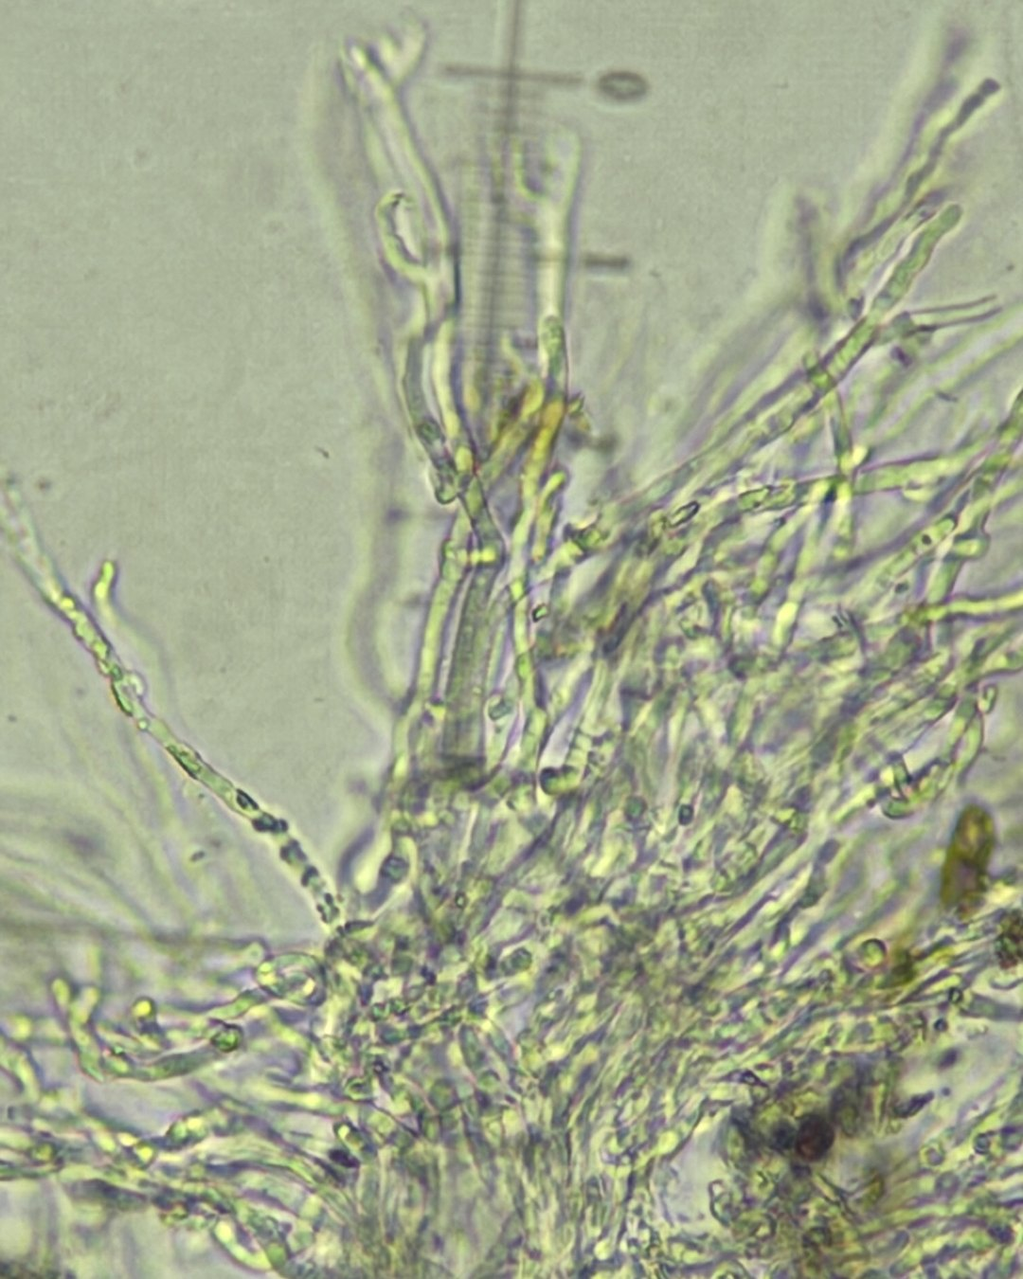

Microbial residues, including fungal necromass, make up a large share of stable soil organic carbon.
Fungal hyphae. Photo: Matthew Rozanoff, CC BY 4.0

Slide 7
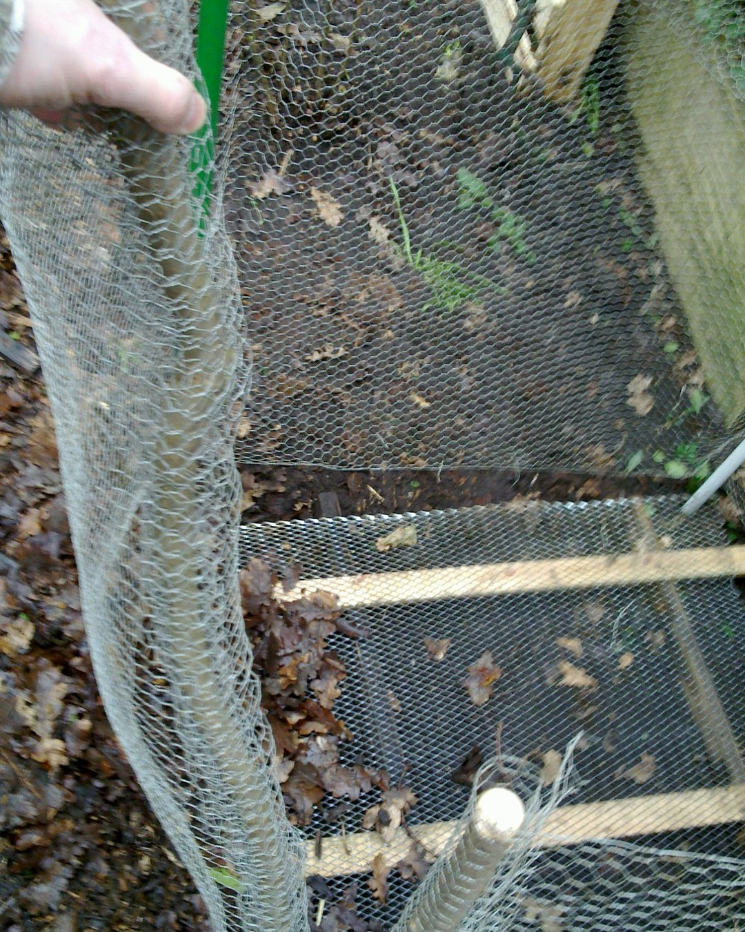
On lawns: shred the leaves and move them to your beds.
Photo: United Diversity, CC BY 2.0

