Slide 1

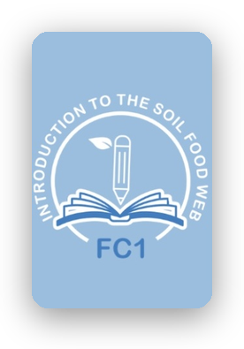
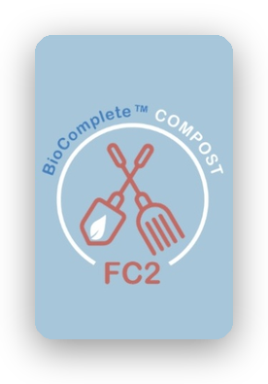
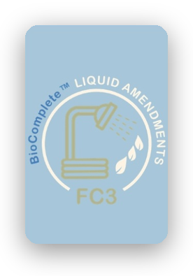

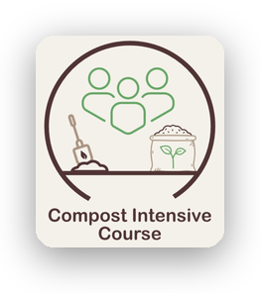

Foundation Courses + Compost Intensive
Fall Enrollment Special, until 2 December.
+ a seat in a 2027 Compost Intensive cohort
10 weeks, live and online

Slide 2




Learn what your
soil needs. Then build
it yourself.
The Soil Food Web
BioComplete™ Compost
BioComplete™ Liquid Amendments
Microscopy
Self-paced. Start today.
Until 2 December.

Slide 3






From soil science to compost you made yourself.
01
02
03
Start today
Pick your cohort
Keep your compost
4 courses, self-paced
January, May or August
Two batches, at home
Until 2 December.

Slide 4


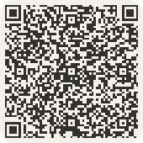
Everything in one bundle
4
10
Foundation Courses
weeks live with a mentor
2
100s
batches of compost you keep
of hours of Dr. Elaine's webinars
Until 2 December.
Link in bio.

