Slide 1
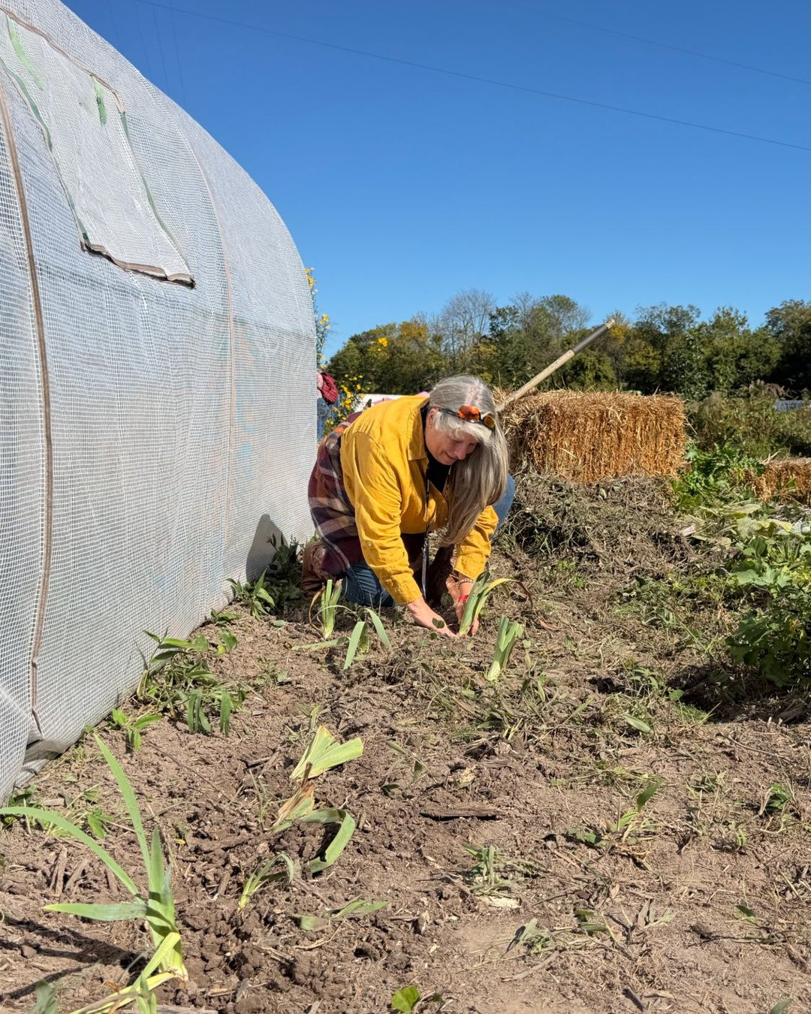


Happy Veterans Day
To every veteran who now farms

Slide 2
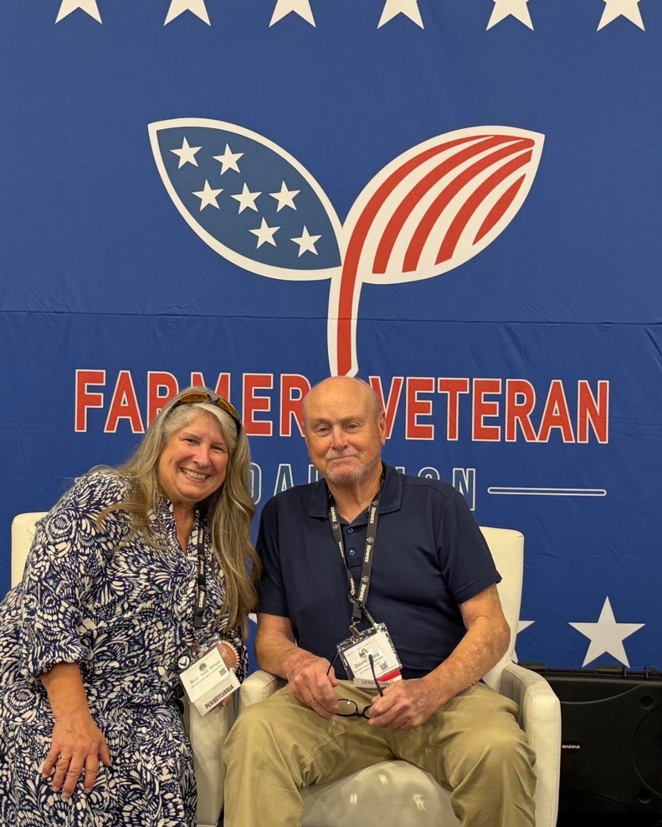

Scaling Sustainably
Suzanne Shea at the Farmer Veteran Coalition Stakeholders Conference

Slide 3


