Slide 1
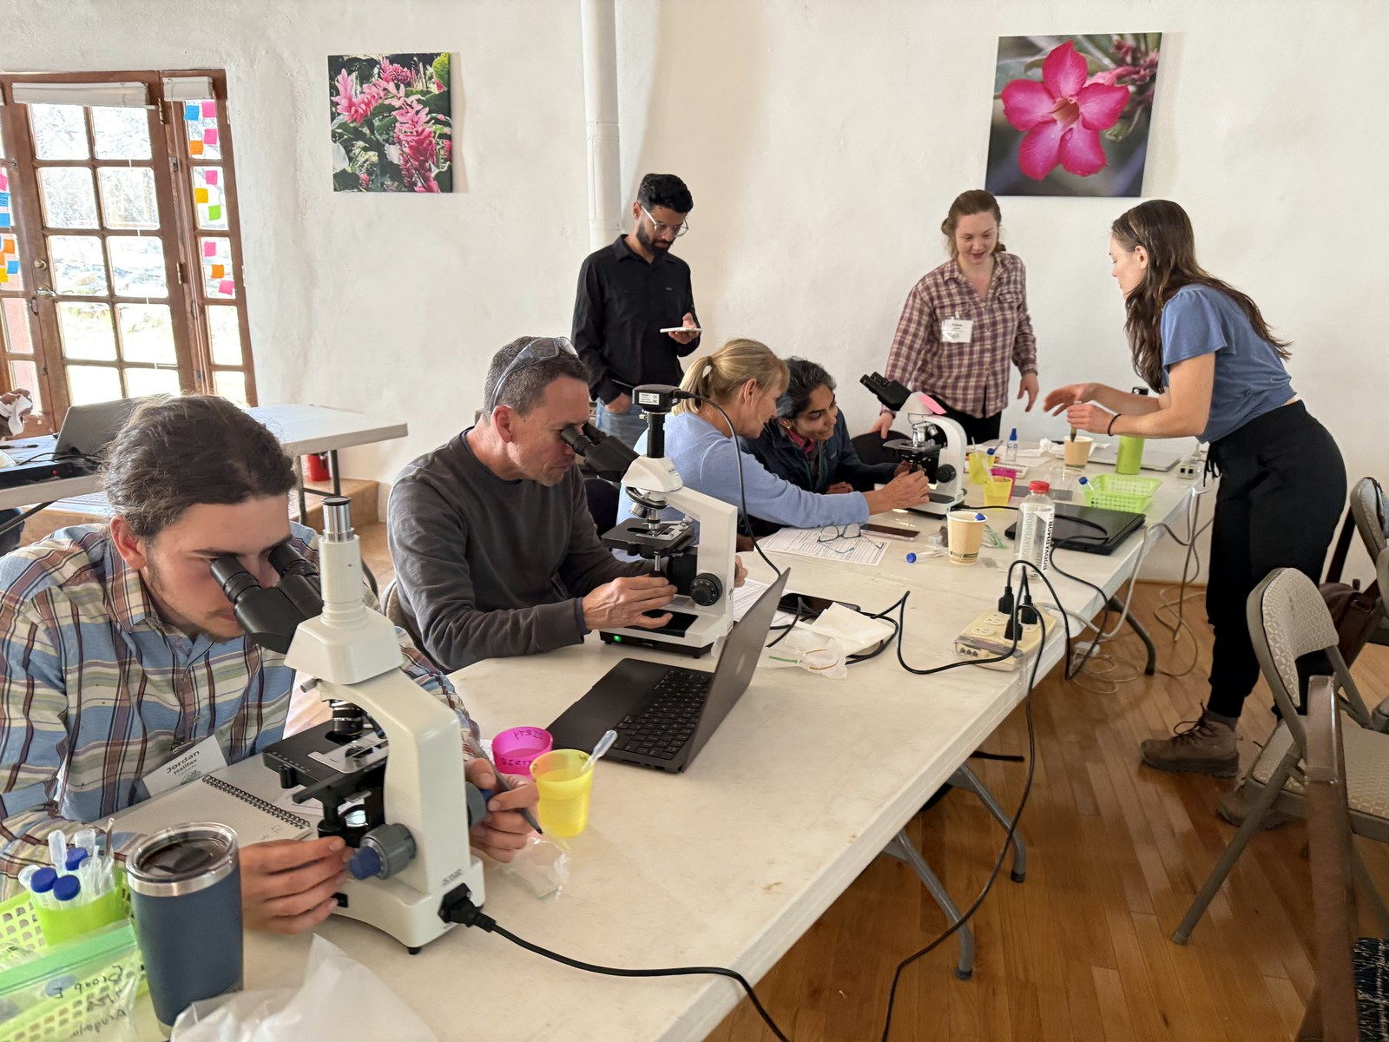

Help us regenerate 100,000 acres in 2027
[Campaign details from Stephanie]
Donate, link in bio.

