Slide 1

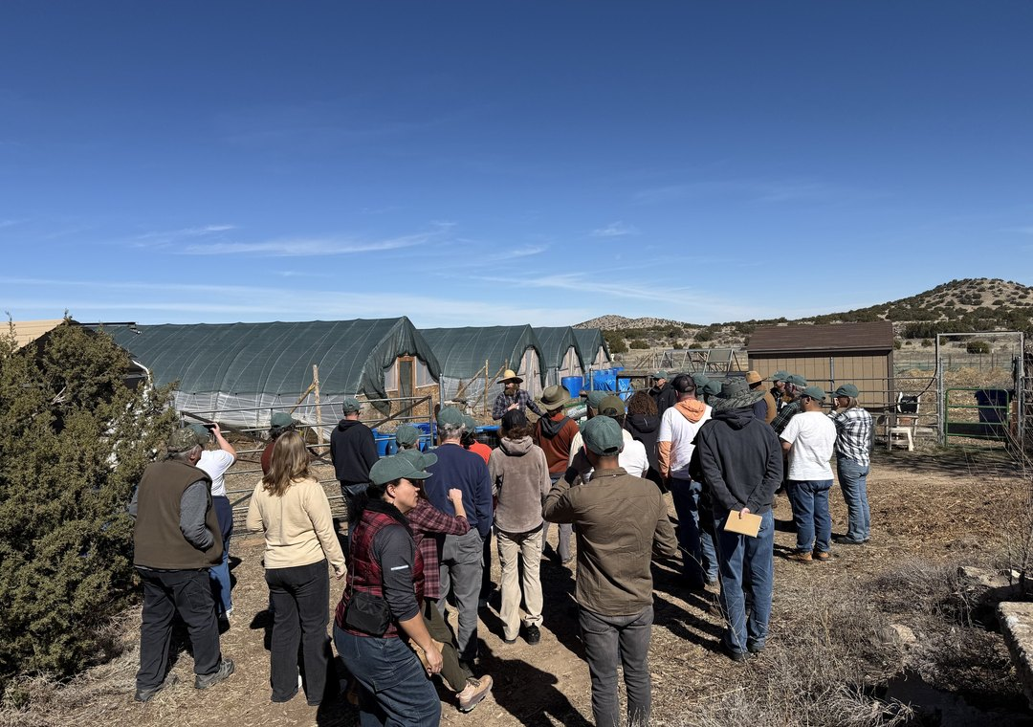

Synergia Ranch, February 2026
New Mexico, May 2027
Our Accelerator Workshop, 3 to 14 May, at Synergia Ranch.

Slide 2

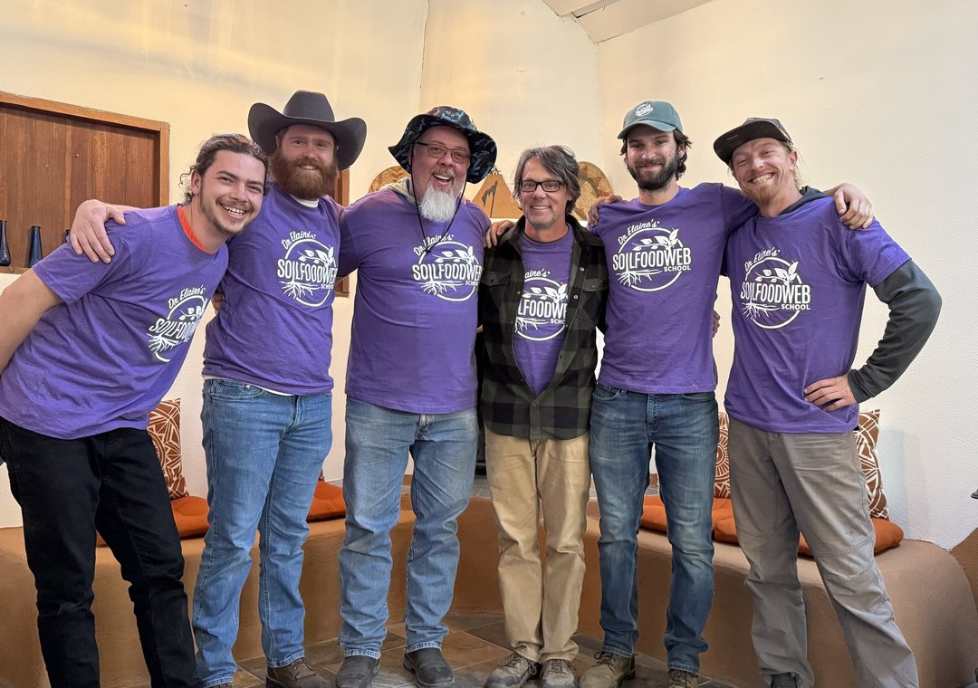
Our mentors, Santa Fe, February 2026
Learn with our mentors
Ten days in person, in small groups, each guided by a mentor.

Slide 3

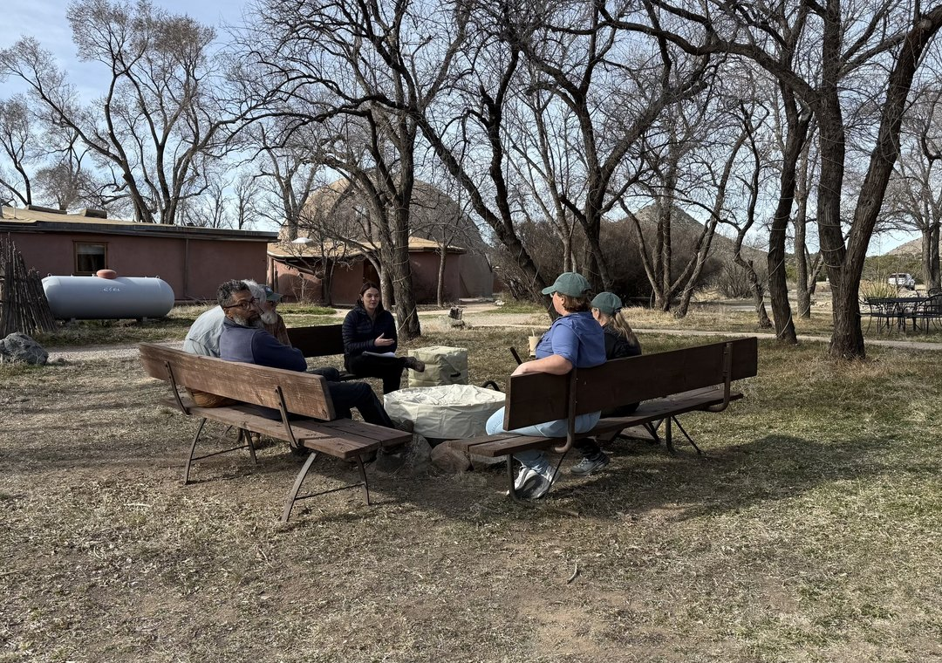
Synergia Ranch, February 2026
Join the waitlist
Choose New Mexico on the workshop interest form. Link in bio.

