Slide 1

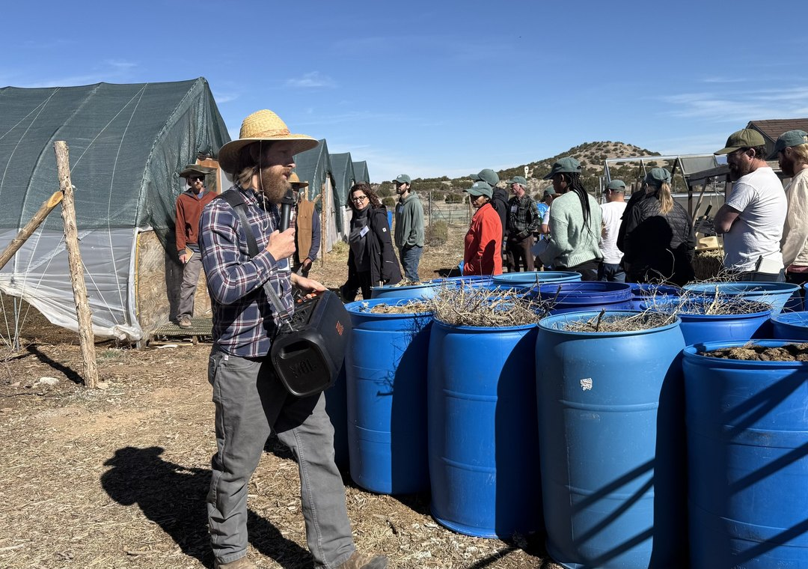

Synergia Ranch, February 2026
Build the pile
Choose feedstocks, then build, monitor and maintain your compost piles.

Slide 2

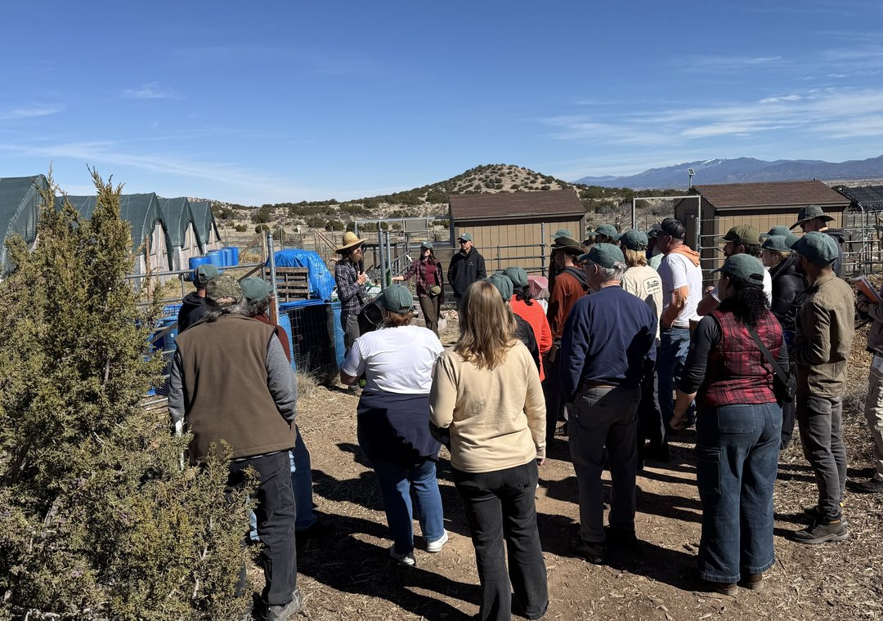
Synergia Ranch, February 2026
Learn in small groups
Each group works with a mentor on compost, extracts and teas.

Slide 3

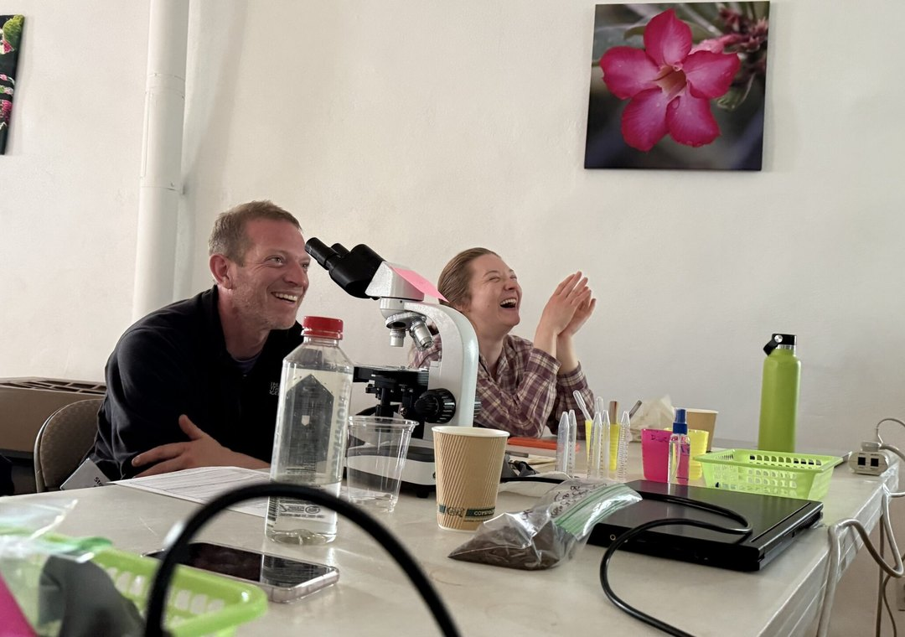
Photo: Soil Food Web Foundation
Read it under the scope
Microscopy for beginners and advanced students. 3 to 14 May 2027.

