Slide 1
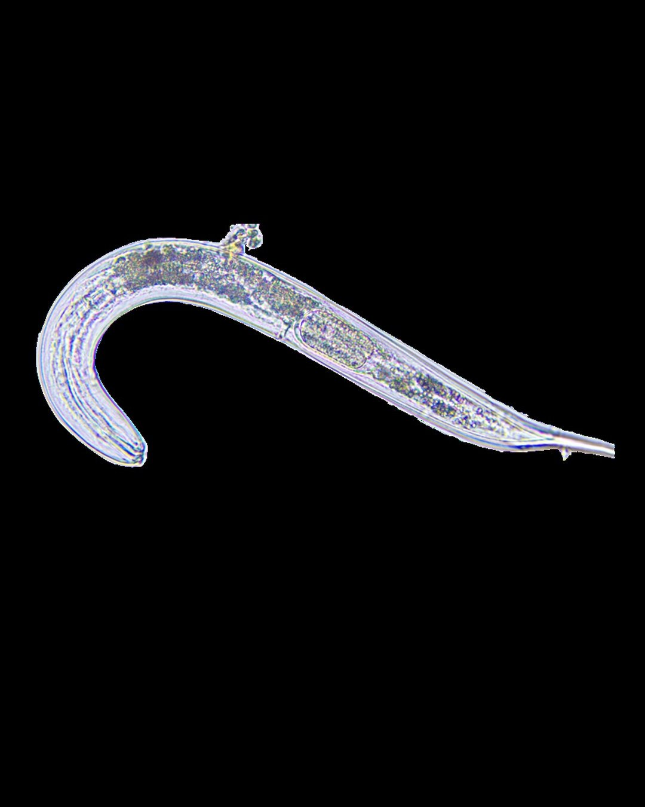

The most common
animal on earth
440 quintillion
nematodes
Photo: Soil Food Web Foundation

