Slide 1




SMALL BUSINESS SATURDAY
Colleen
Dempster
Rewild Soils, Uxbridge, Ontario

Slide 2


“
Most people have never seen the microbes that make up the soil food web, so I show pictures and do live microscope demonstrations
Colleen Dempster
More than 300
microbial reports
from her lab

Slide 3



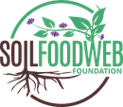
Colleen’s path
2018
making compost and compost
tea, and analysing samples
2022
her lab became Soil Food Web
certified, re-certified every year
Now
in the final stages of the Soil
Food Web Consultant Program

Slide 4

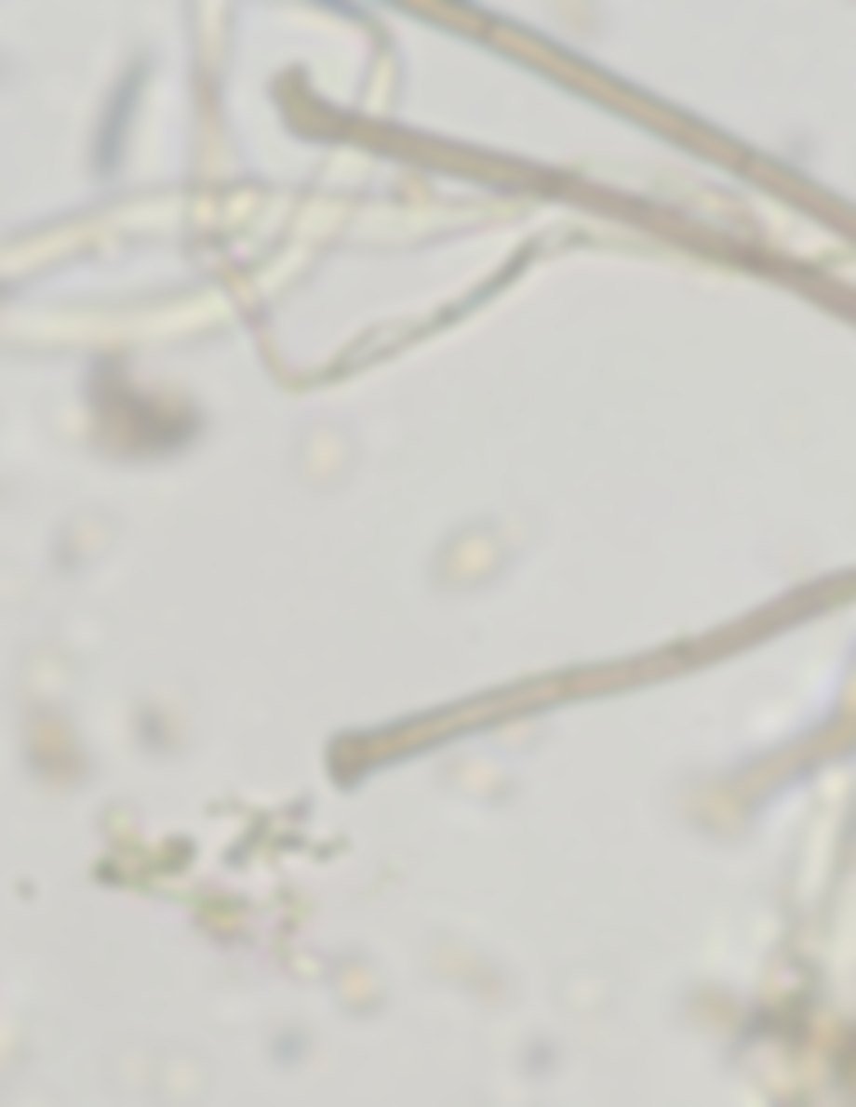
“
Making compost and exploring samples under the microscope will always be something I enjoy
Colleen believes rewilding soils with microbes is about restoring systems and people’s connection with the Earth

Slide 5


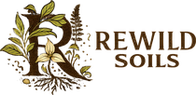
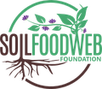
“
I am ready for when the clients are ready
Colleen Dempster
What a Soil Food Web lab can do for you:
Microbial analysis of your soil
Quality checks for your compost, teas and extracts
Advice on what your soil needs next
Find a Soil Food Web consultant
or lab near you
Link in bio

