Slide 1
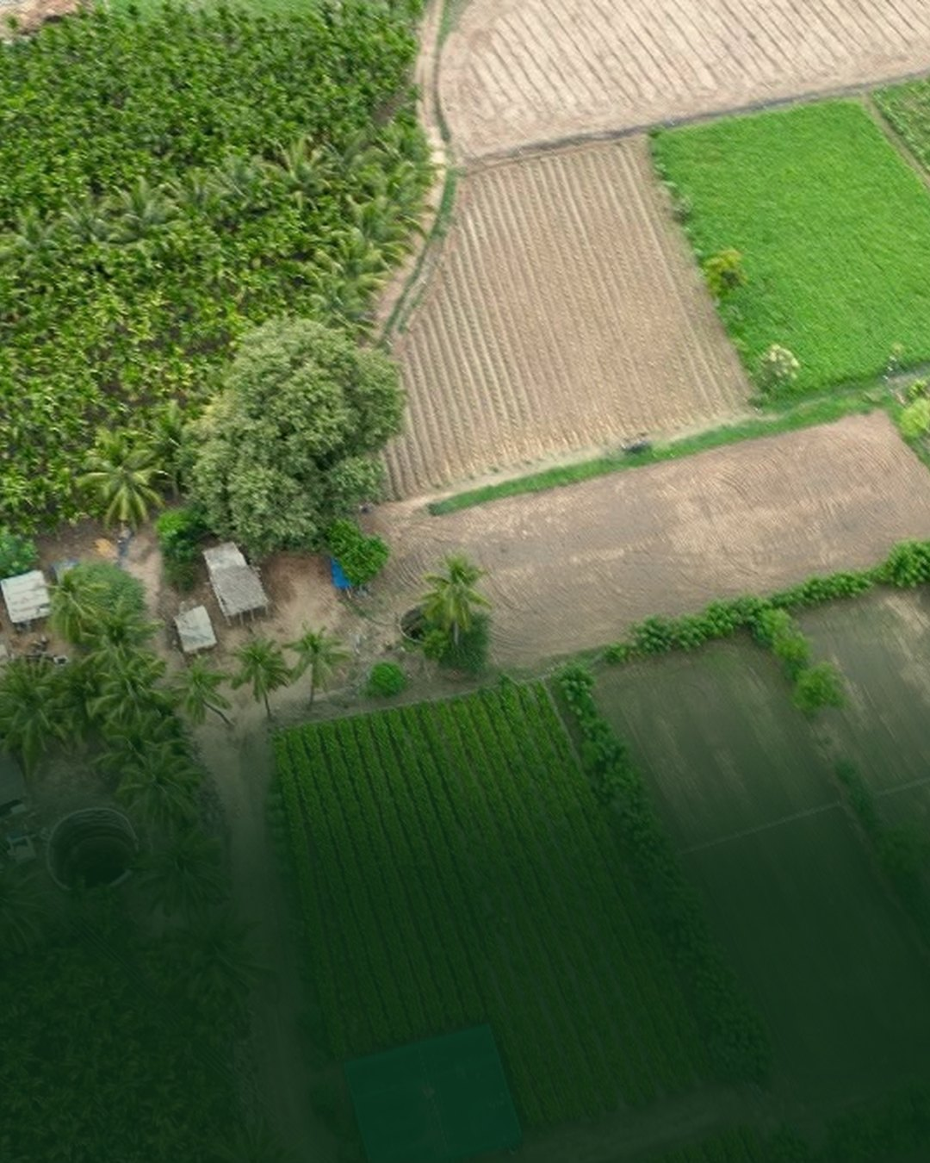
There is a farmer somewhere right now watching their soil fail.

Slide 2
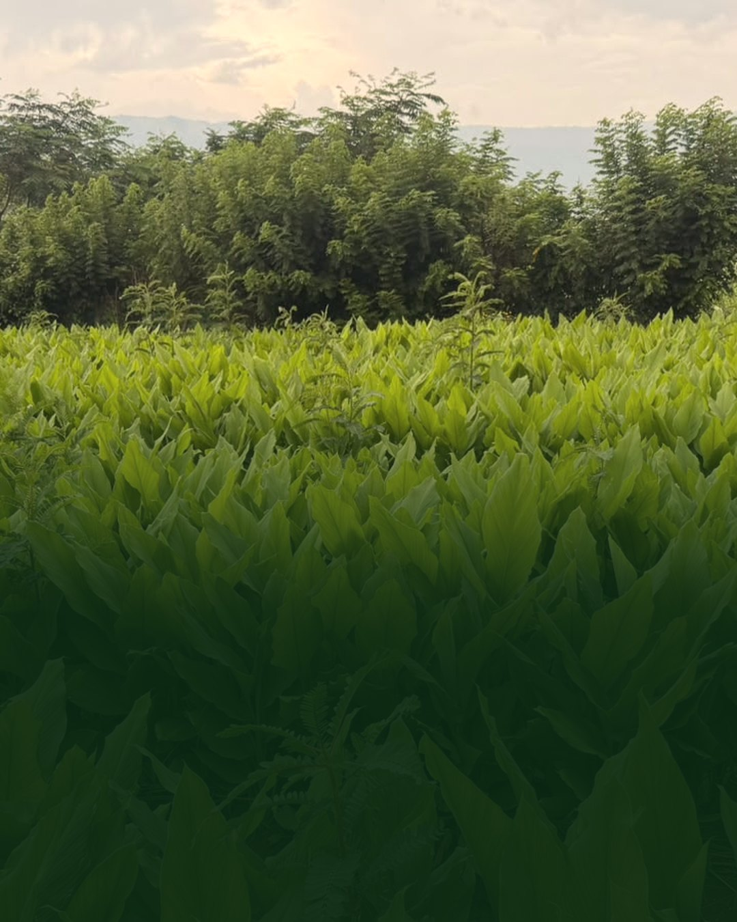

The soil can recover.
It wants to.
A generous donor is matching every gift through the end of the year, so your donation goes twice as far.
Donate today

Slide 3
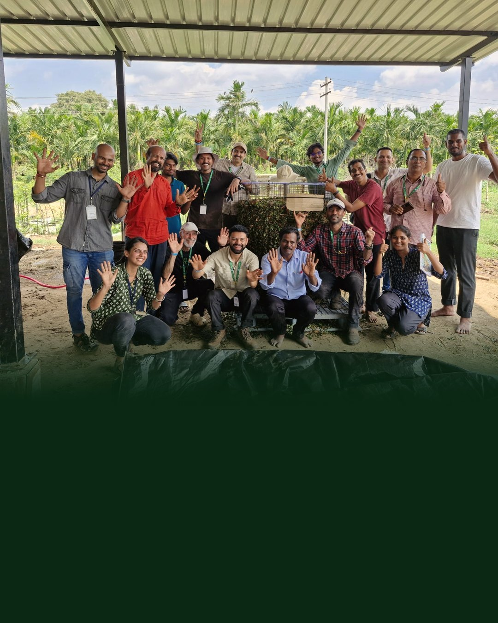

We partnered with the Isha Foundation to host our first in-person Accelerator Workshop in India! This group featured 46 students from 10 countries

