Slide 1







Foundation Courses + Compost Intensive
Fall Enrollment Special
Until 2 December.

Slide 2


The Foundation Courses teach you to work out what your soil needs.
Four courses, 63 lectures and about 150 hours of study, with 40+ years of Dr. Elaine's knowledge. Self-paced, start the day you enroll.

Slide 3


The Compost Intensive Course teaches you to make it.
Ten weeks online, with a 90-minute live session with a mentor every week, alongside a global cohort of peers. You build 2 compost piles right where you live.

Slide 4


For farmers, ranchers, agronomists, consultants and gardeners
At any scale. The Compost Intensive covers thermophilic piles, vermicompost, USDA thermal composting and large-scale windrows.

Slide 5


Plus hundreds of hours
of webinars with Dr. Elaine
Learn directly from the founder of the Soil Food Web School, in our legacy webinar archive recorded live with Dr. Elaine Ingham. 40+ years of her knowledge, science and land management practices, proven across the globe.

Slide 6


Start today.
Pick your season.
01
Start today
4 courses, self-paced
02
Pick your cohort
January, May or August 2027
03
Build 2 compost piles
Right where you live
Fall Enrollment Special
Until 2 December.

Slide 7

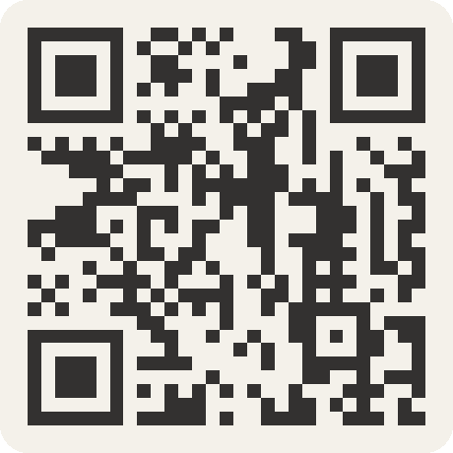
Foundation Courses + Compost Intensive
Fall Enrollment Special
Until 2 December.

