Slide 1
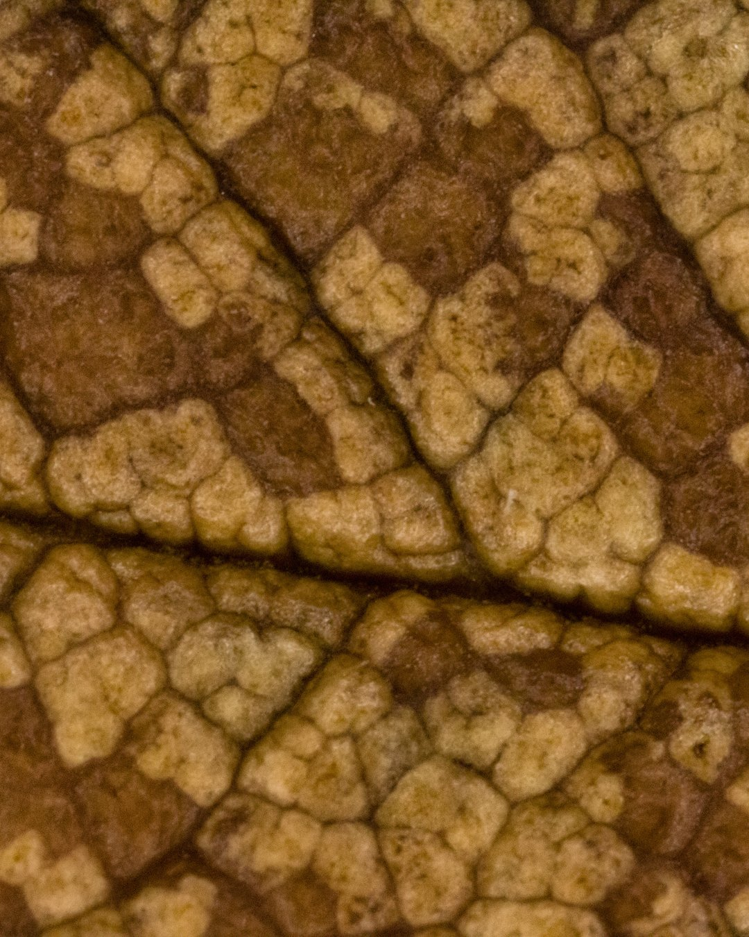


Leave the leaves.
Photo: David Lee, CC BY 2.0

Slide 2
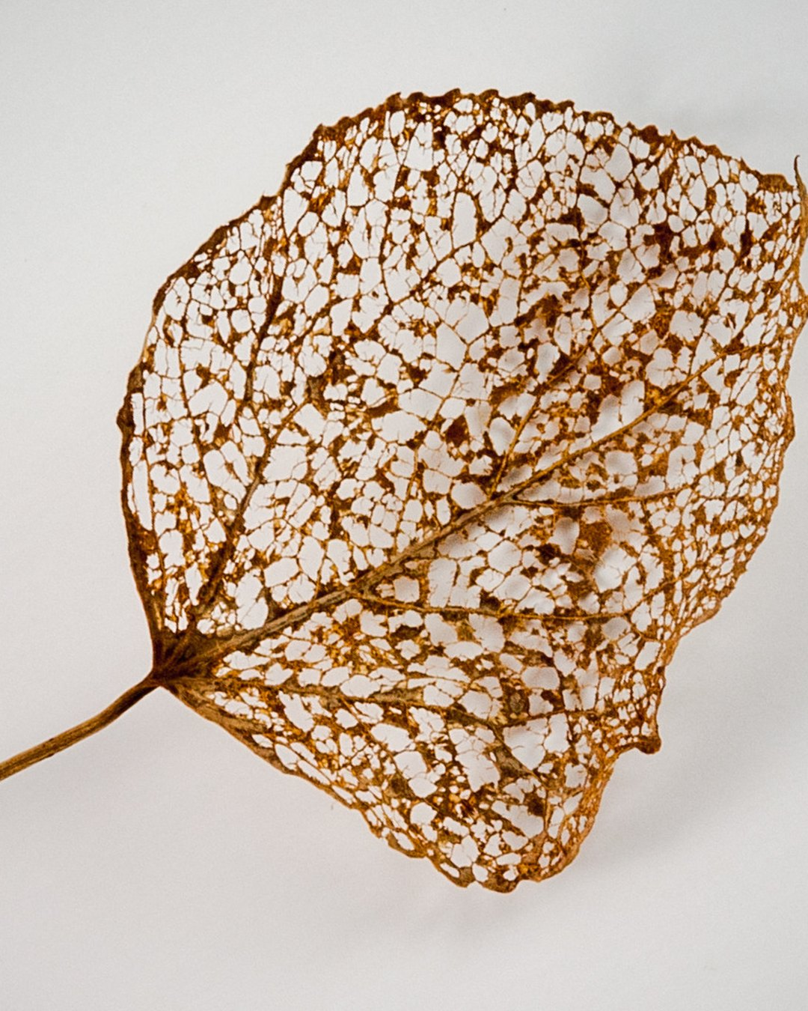

Leaves are carbon and lignin.
Photo: Paul VanDerWerf, CC BY 2.0

Slide 3
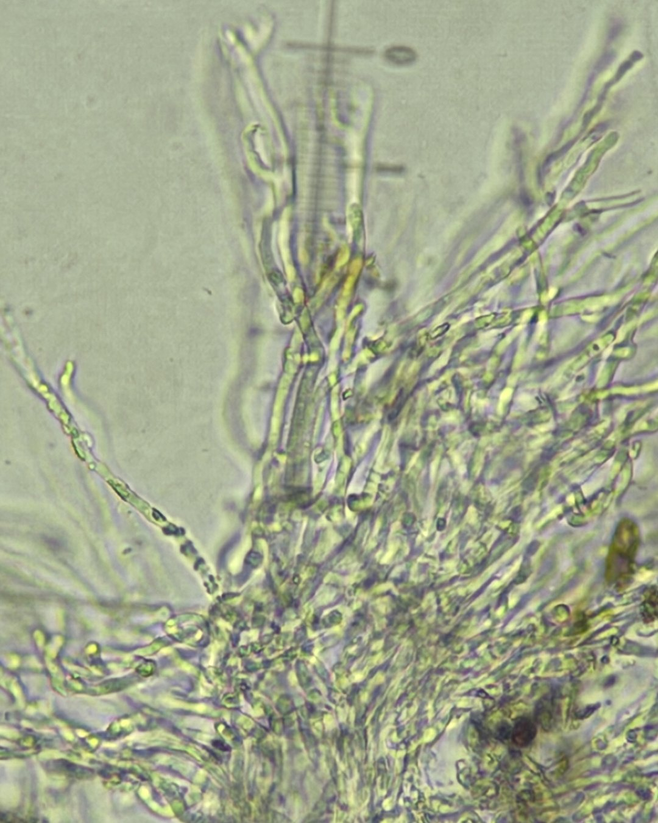
Fungi break down lignin.
Photo: Matthew Rozanoff, CC BY 4.0

Slide 4
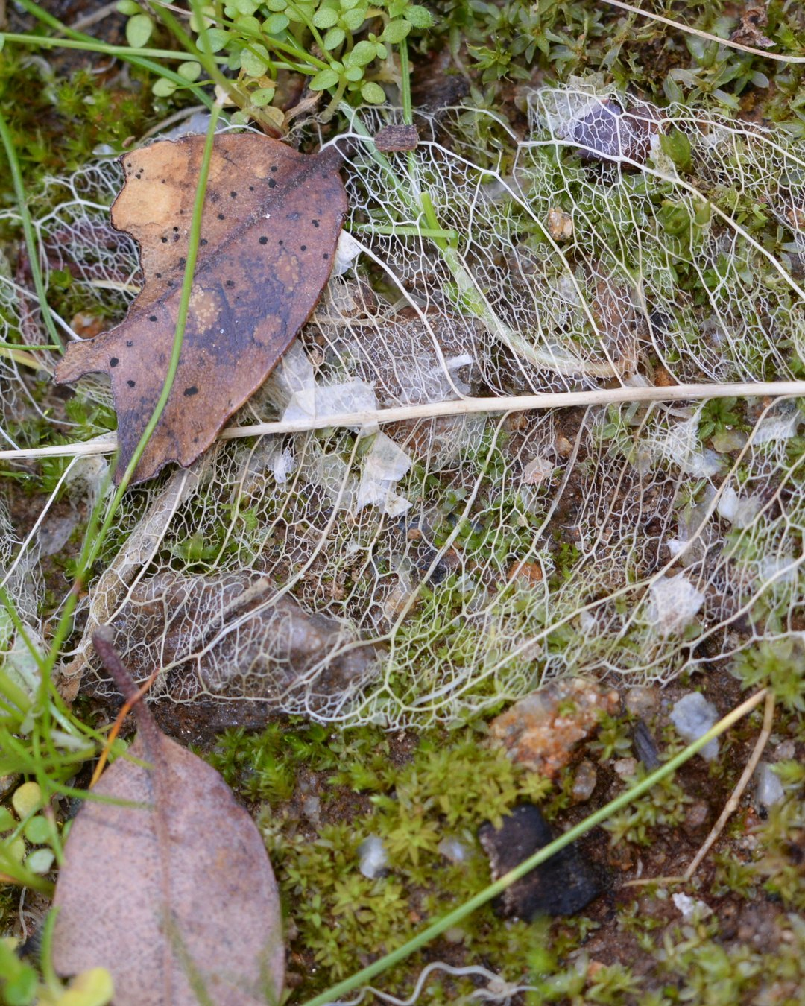
Leaf litter feeds the fungi.
Photo: Jim Whitehead, CC BY 2.0

Slide 5


Trees love fungal soil
More fungi moves the soil toward the fungal dominance perennials, shrubs and trees prefer.

Slide 6

A blanket for winter
A litter layer shields the soil from raindrop impact over winter. Fungal residues become stable soil carbon.

Slide 7

Shred them onto your beds
On lawns: shred the leaves and move them to your beds.

