Slide 1


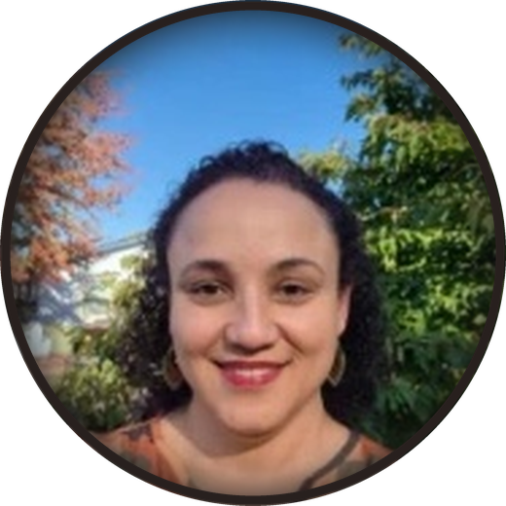


Tomorrow
Watch Carla live
Sunday 15 November
7 to 7:45am Pacific
Food as Medicine for All · Livestream
LINK STICKER HERE

