Slide 1


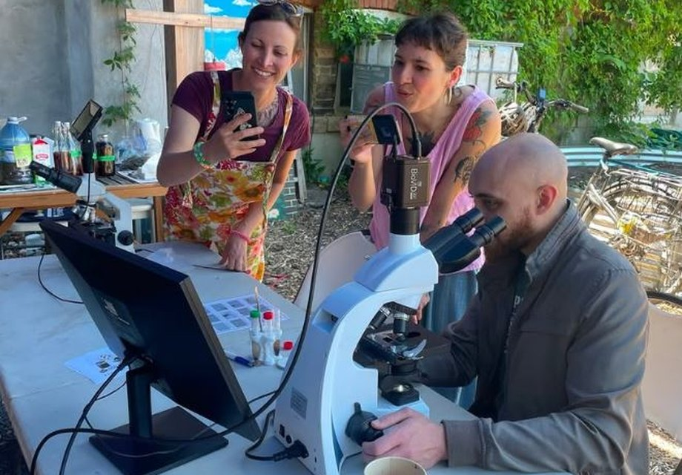

On Small Business Saturday, we salute our Soil Food Web Consultants and Lab-Techs, like Colleen Dempster, a Lab-Tech since 2022 who is completing her Consultant certification.

Slide 2

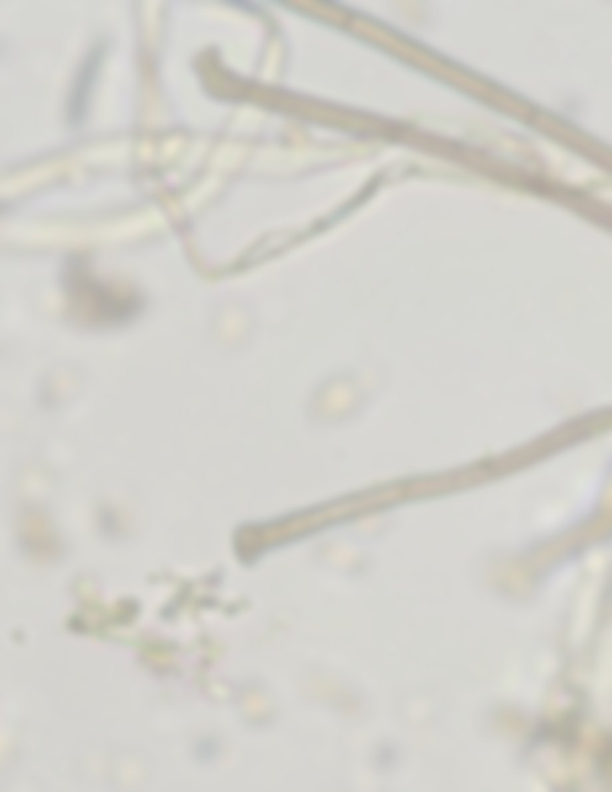
In addition to working as a Lab-Tech at her business, Rewild Soils, in Uxbridge, Ontario, Colleen also offers lectures and demonstrations.
“
Making compost and exploring samples under the microscope will always be something I enjoy. A big part of my work is educating people about soil health in the context of soil biology. Most people have never seen the microbes that make up the soil food web, so I show pictures and do live microscope demonstrations.

Slide 3


When you need a soil or compost sample analyzed or need help in transitioning your farm or garden to the Soil Food Web Approach, find certified Lab-Techs and Consultants nearest you on our website:
soilfoodweb.com/
find-a-professional

