Slide 1


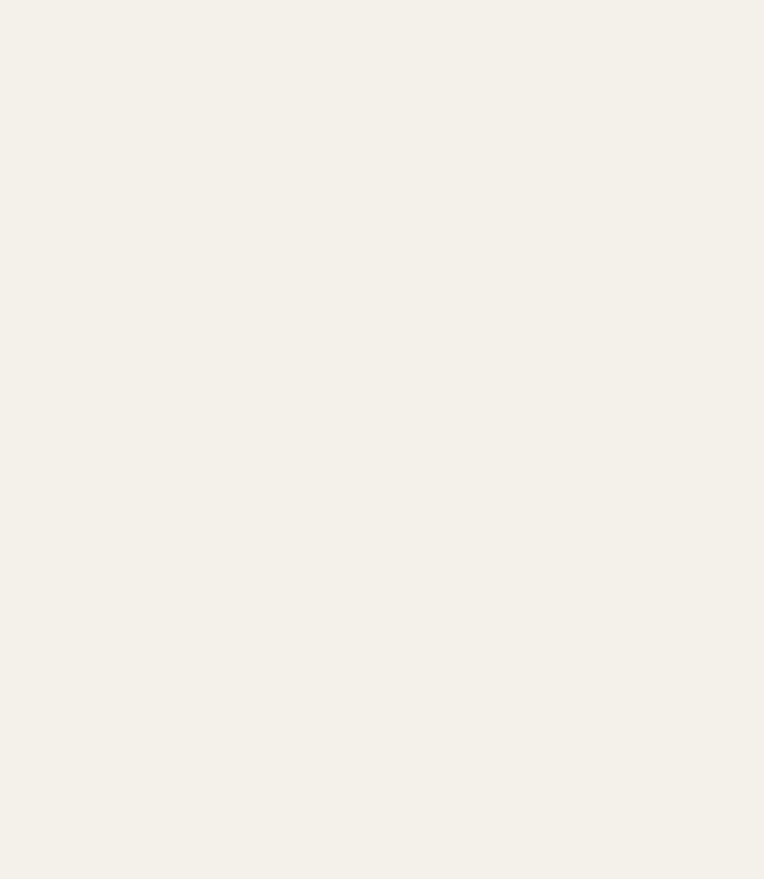
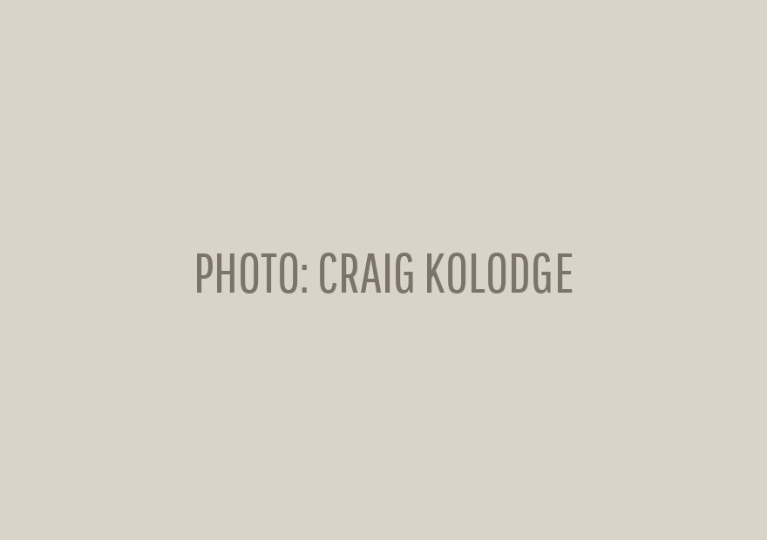


Free webinar
Live today, 9am Pacific
Dr. Craig Kolodge: why nematodes make great compost.
Register

