Slide 1



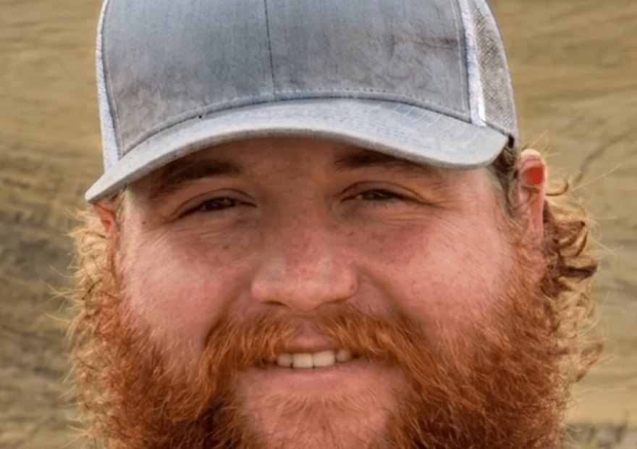


Free webinar
Live today, 9am Pacific
Matt Drane: 15 years of regenerative corn and soy.
Register

