Slide 1



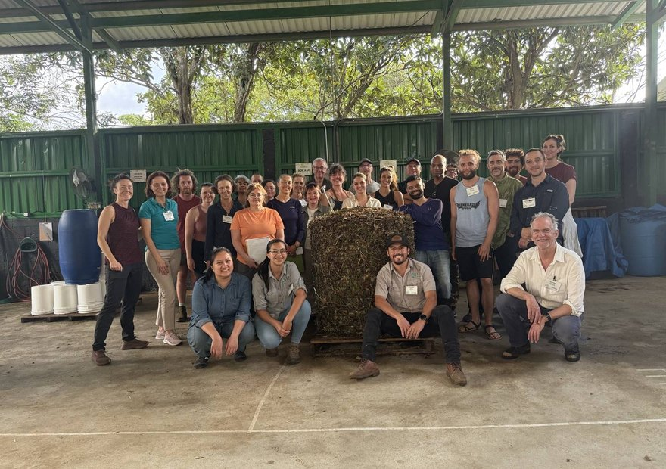


Costa Rica
Info session tomorrow
Fri 6 Nov, 12pm Pacific, on Zoom. Free, and recorded.
Sign up

