Slide 1



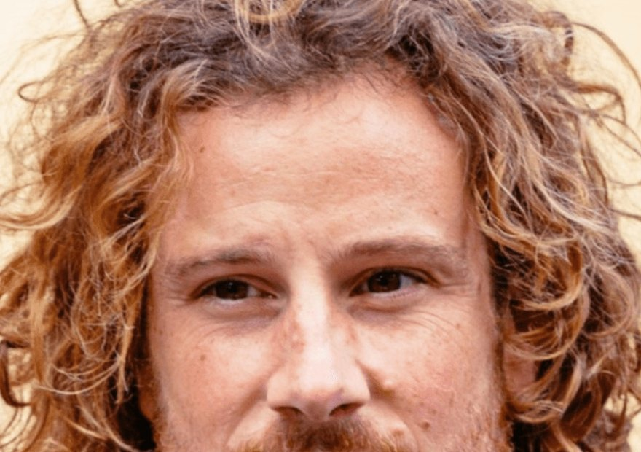


Free webinar
Live today, 9am Pacific
Juan de la Serna: Johnson-Su compost on real farms.
Register

