Slide 1



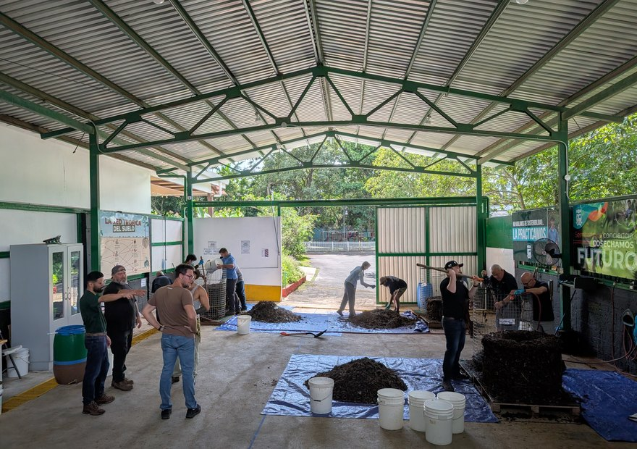

Costa Rica
Finished the Foundation Courses?
Your next step: our Accelerator Workshop, 18 to 29 January 2027.

