Slide 1



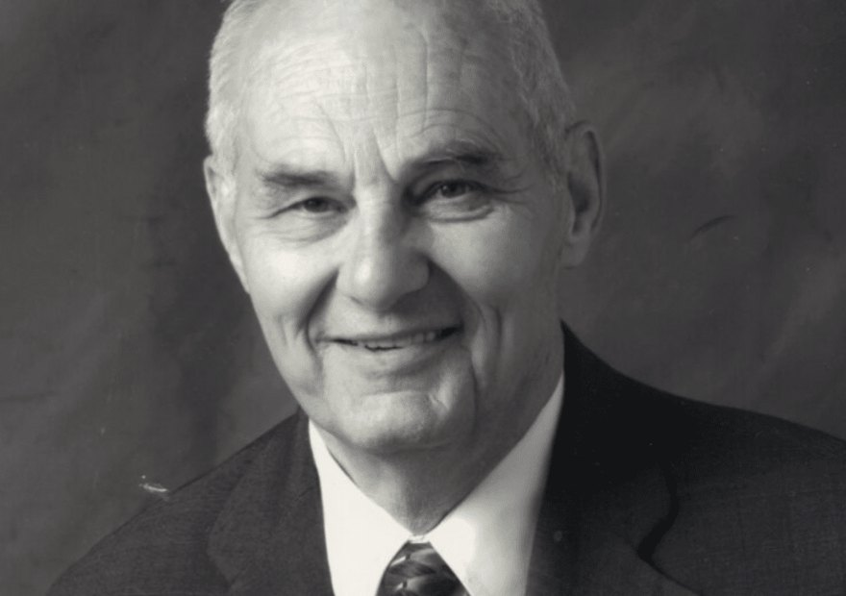


Free webinar
Live today, 9am Pacific
Dr. Don M. Huber: agriculture beyond glyphosate.
Register

