Slide 1



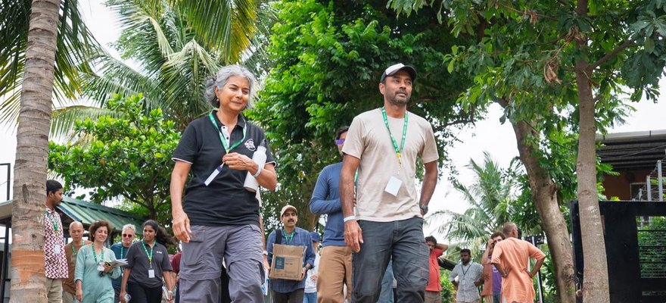


The Times of India
Photo: Soil Food Web Foundation, Coimbatore
We made the Times of India
Our India Accelerator Workshop, Coimbatore, Tamil Nadu.
Read More
Source:
timesofindia.indiatimes.com/
articleshow/135370094.cms

Slide 2


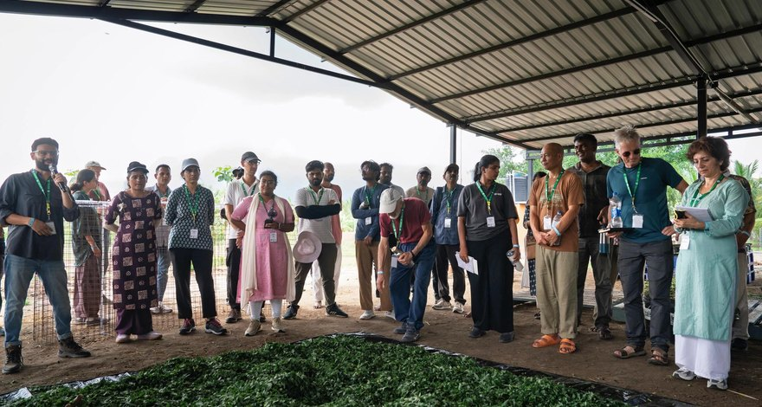
46 participants from 10 countries
Farmers, soil scientists, microbiologists and consultants.

Slide 3

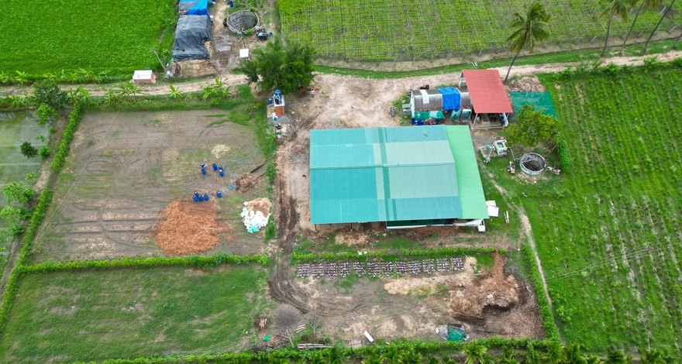
The Save Soil model farm
Ten days at Sadhguru's Save Soil Regenerative Revolution farm.

Slide 4

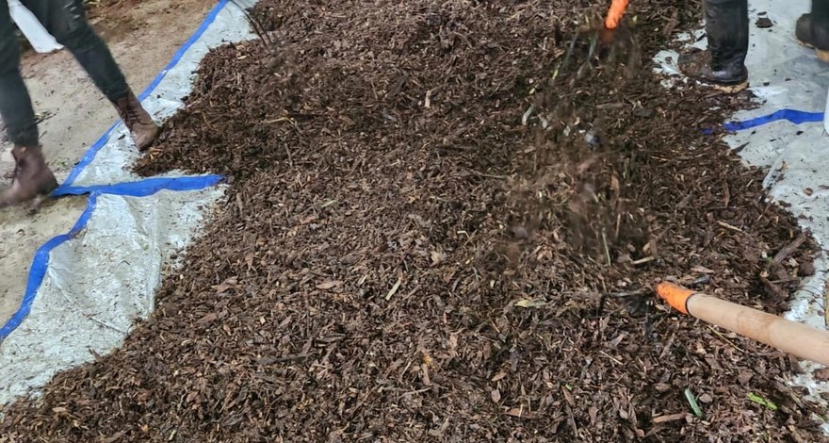
Compost to microscope
BioComplete™ compost, extracts, teas and soil sampling.

Slide 5


Read the article
The Times of India, 30 October 2026. In collaboration with Isha Outreach. Link in bio.

