Slide 1


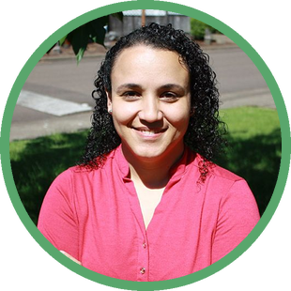
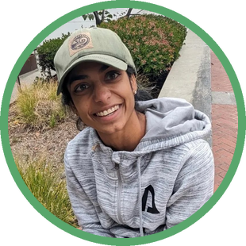

INTERNATIONAL WOMEN'S DAY
Four women on permaculture, soil and community
PHOTO: CLEA
PHOTO: KELDA
CLEA CHANDMAL
KELDA LORAX
DR. CARLA PORTUGAL
KAVI REDDY

Slide 2

THE PANEL
Women Seeding Regenerative Futures
CLEA CHANDMAL
Permaculture science rooted in plant molecular physiology.
KELDA LORAX
30 years of permaculture education and a deep commitment to justice in land relationships.
DR. CARLA PORTUGAL
Research across Brazil and the United States. Instructor, mentor and translator at the Soil Food Web School.
KAVI REDDY
Systems thinking across soil fertility, food systems and global partnerships.

Slide 3

WATCH THE FULL PANEL
Learn and grow together with four extraordinary forces of nature.
An all-woman panel of experts in permaculture and regenerative design, recorded live on 2 September 2026. Free to watch.
LINK IN BIO
webinar.soilfoodweb.com

