Slide 1



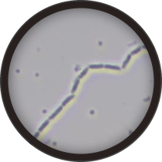
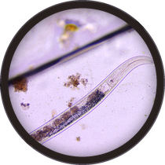

Tomorrow, live · Carla Portugal
Restoring the soil food web to grow nutrition your patients need
Sunday 15 November, 7 to 7:45am Pacific
Food as Medicine for All · Livestream

