Slide 1


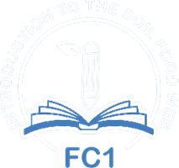


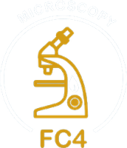

Foundation Courses + Compost Intensive
Fall Enrollment Special
Until 2 December.

Slide 2


The Foundation Courses teach you to work out what your soil needs.
Four courses, 63 lectures and about 150 hours of study, with 40+ years of Dr. Elaine's knowledge. Self-paced, start the day you enroll.

Slide 3

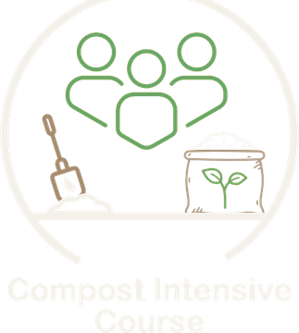
The Compost Intensive Course teaches you to make it.
Ten weeks online, with a 90-minute live session with a mentor every week, alongside a global cohort of peers. You build 2 compost piles right where you live.

Slide 4


For farmers, ranchers, agronomists, consultants and gardeners
At any scale. Thermophilic piles, vermicompost, USDA thermal composting and large-scale windrows.

Slide 5


Plus hundreds of hours with Dr. Elaine
Instant access to our legacy webinar archive, recorded live with Dr. Elaine Ingham.

Slide 6

From our students
“I had so much fun learning about regenerative agriculture.”
Zoë Unruh, Canada
“The classes are absolutely fabulous!”
Rob Mosier, United States
“This course really makes a difference.”
Emmanuel Morales, United States
“I want to help repair broken food systems by rebuilding life in the soil.”
Anusha Fatima, Pakistan
“Extraordinary body of knowledge.”
Clara Santiago, Portugal

Slide 7


Start today.
Pick your season.
01
Start today
4 courses, self-paced
02
Pick your cohort
January, May or August 2027
03
Build 2 compost piles
Right where you live
Fall Enrollment Special
Until 2 December.

