Slide 1







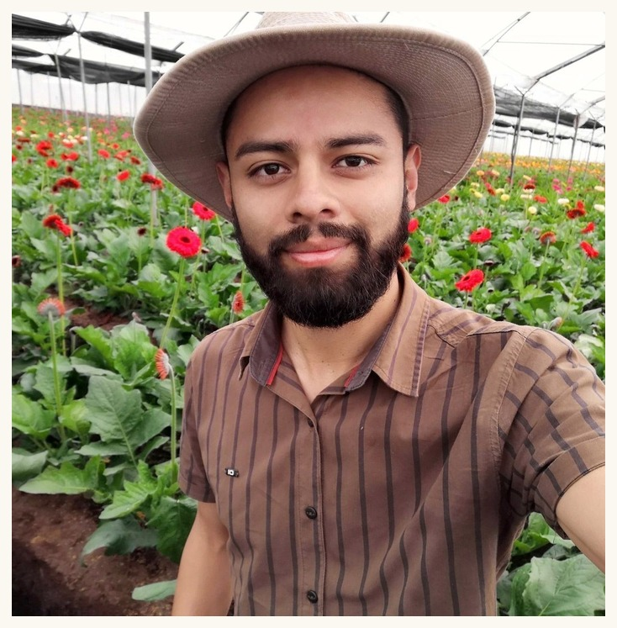












Gerald Ramirez
Soil Food Web Mentor
Notes:
Gerald Ramirez (p06). Linnea's flower-frame design, from her Tommy Tepper image.

Slide 2
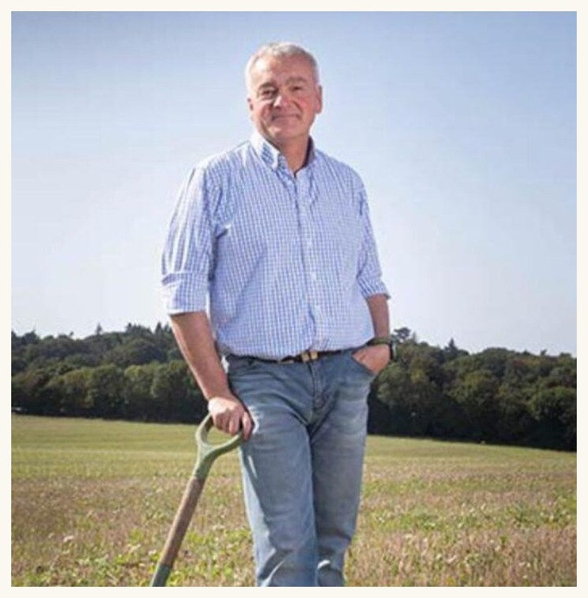
Nick Padwick
Soil Food Web Mentor
Notes:
Nick Padwick (p03). Linnea's flower-frame design, from her Tommy Tepper image.

Slide 3
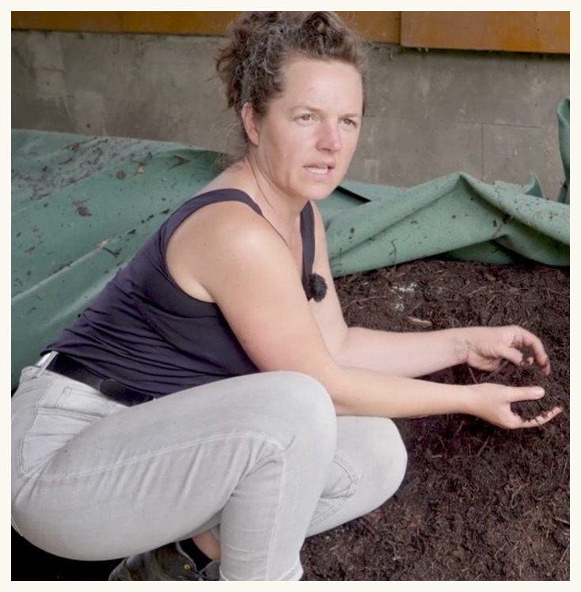
Dora Tkalec
Soil Food Web Mentor
Notes:
Dora Tkalec (p09). Linnea's flower-frame design, from her Tommy Tepper image.

Slide 4
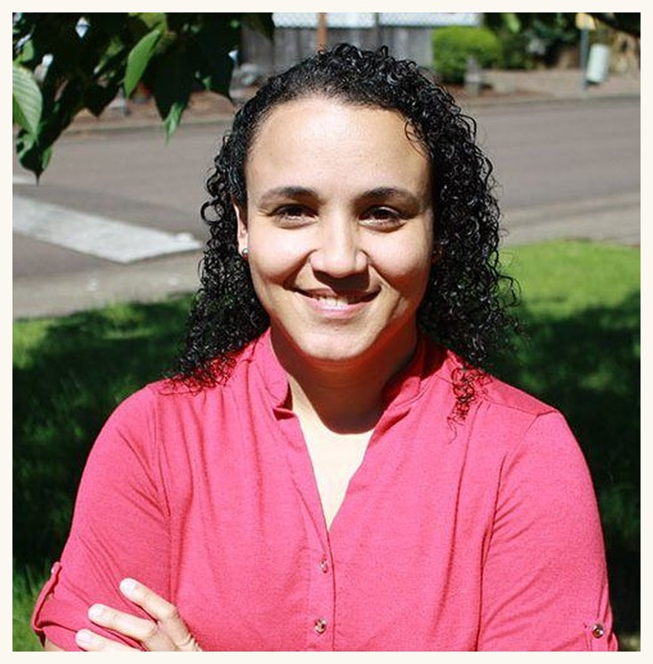
Dr. Carla Portugal
Soil Food Web Mentor
Notes:
Dr. Carla Portugal (d05). Linnea's flower-frame design, from her Tommy Tepper image.

Slide 5
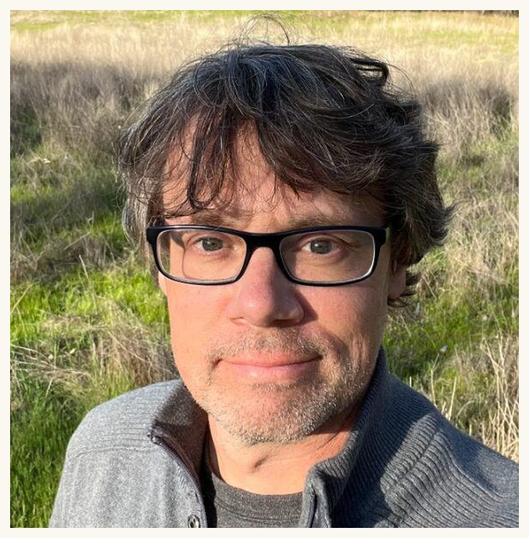
Wes Sander
Soil Food Web Mentor
Notes:
Wes Sander (p04). Linnea's flower-frame design, from her Tommy Tepper image.

Slide 6
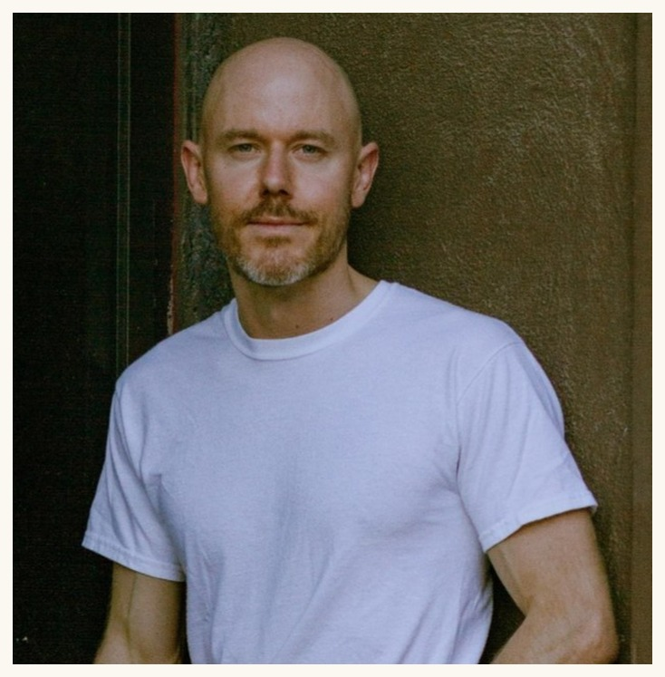
Brian Daubenspeck
Soil Food Web Mentor
Notes:
Brian Daubenspeck (d11). Linnea's flower-frame design, from her Tommy Tepper image.

Slide 7
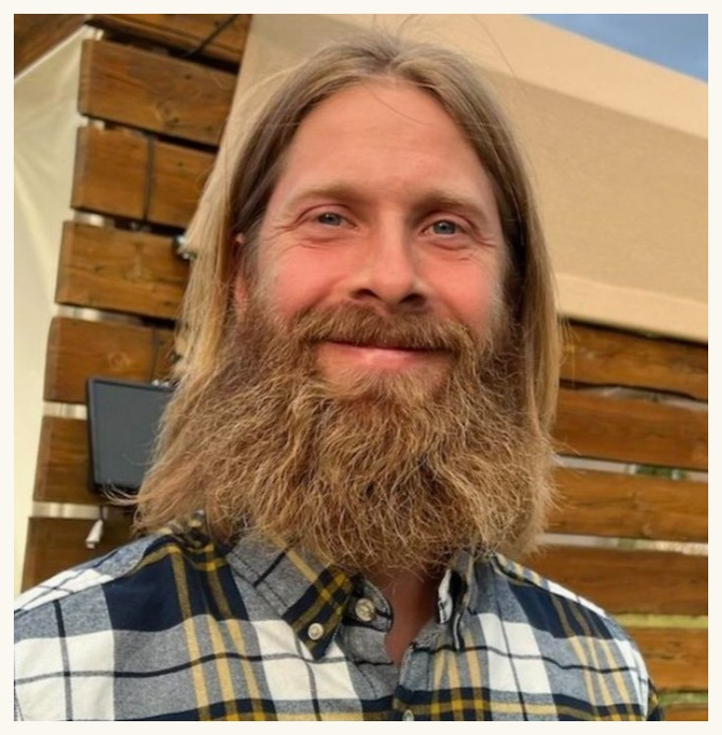
Casey Williams
Soil Food Web Mentor
Notes:
Casey Williams (p02). Linnea's flower-frame design, from her Tommy Tepper image.

Slide 8
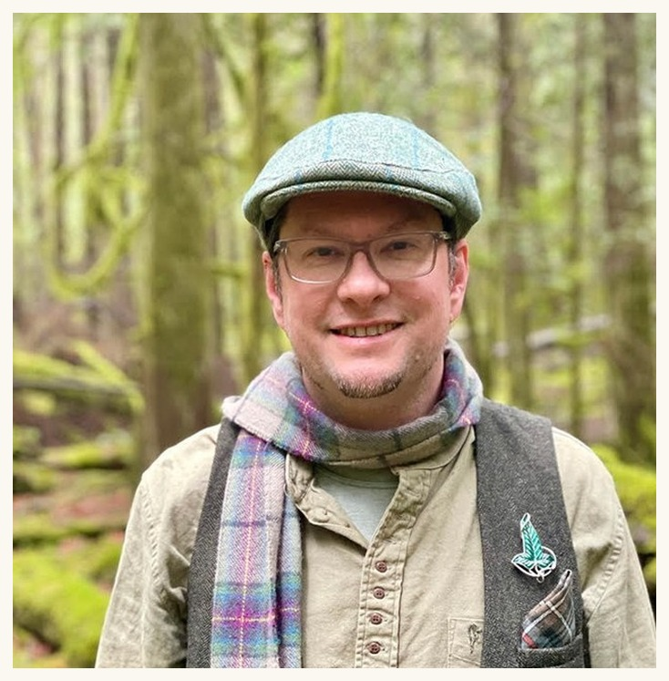
Delvin Solkinson
Soil Food Web Mentor
Notes:
Delvin Solkinson (d12). Linnea's flower-frame design, from her Tommy Tepper image.

Slide 9
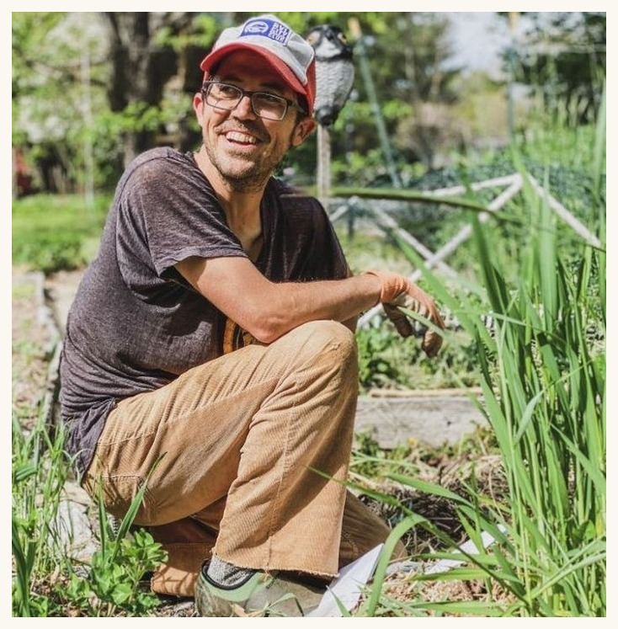
Tommy Tepper
Soil Food Web Mentor
Notes:
Tommy Tepper (d13). Linnea's flower-frame design, from her Tommy Tepper image.

