Slide 1
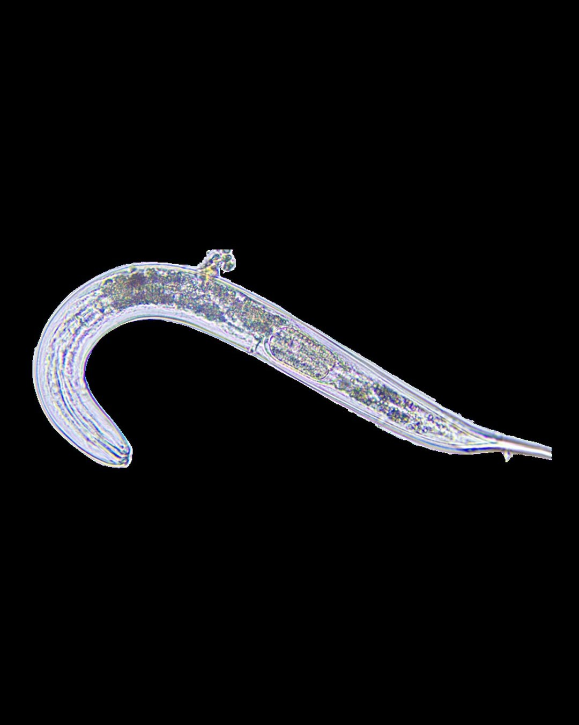



440 quintillion nematodes.
Photo: Soil Food Web Foundation

Slide 2
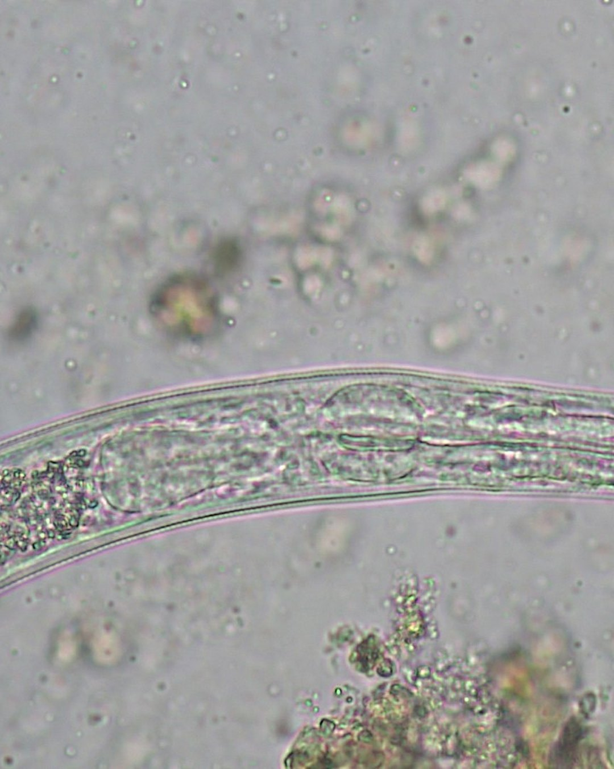

About 57 billion for every person alive.
Photo: Johannes Veith

Slide 3
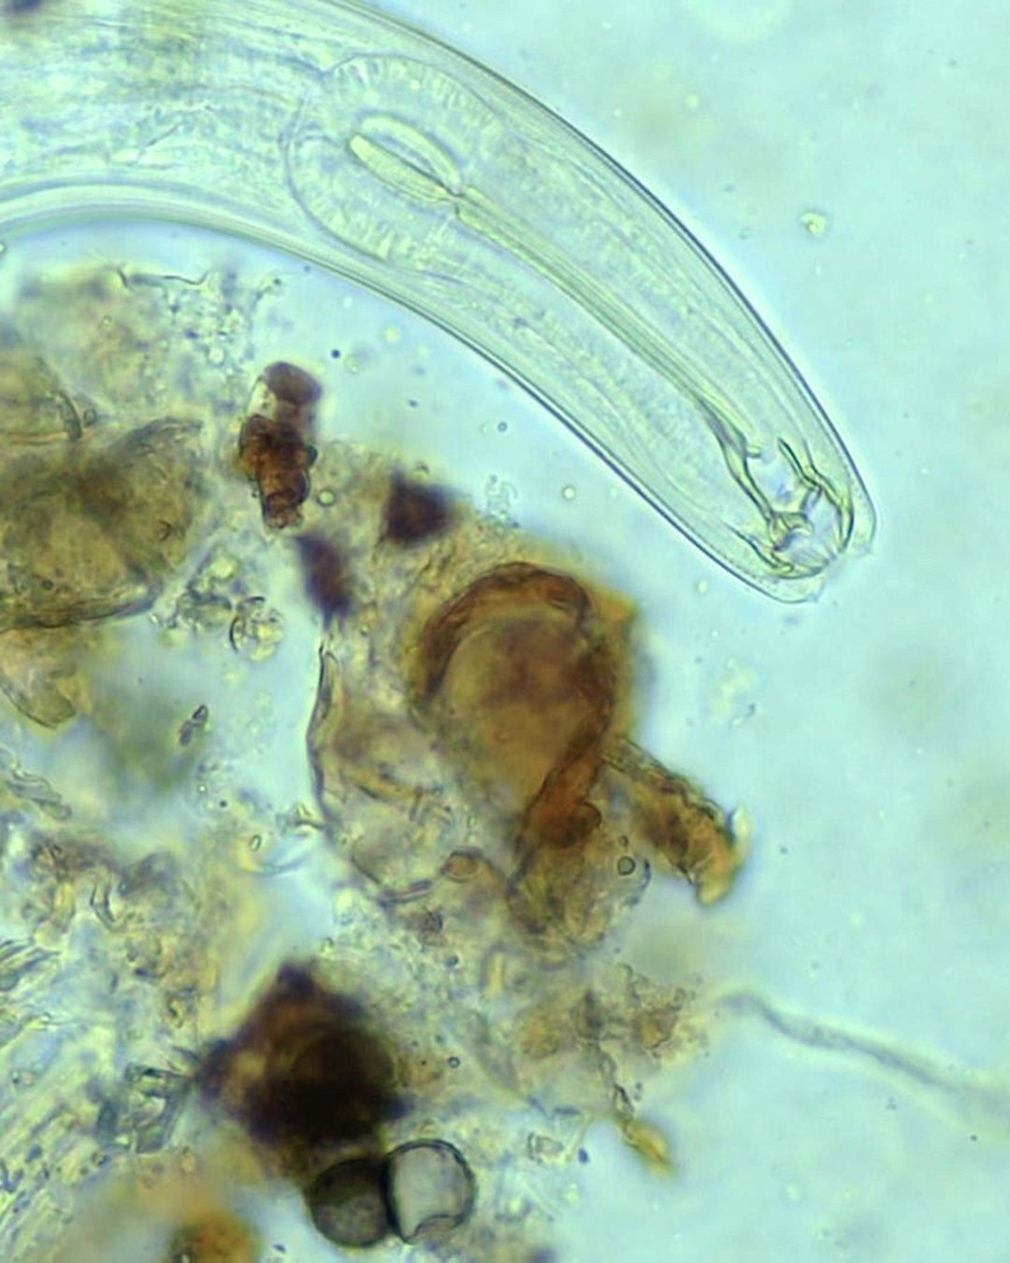
Most feed on bacteria and fungi.
Photo: Keisha Wheeler

