Slide 1

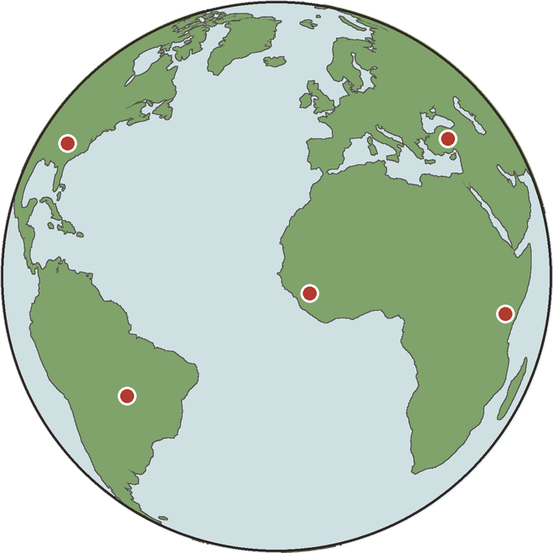

Happy World Soil Day. Here's a year of living soil.
World Soil Day 2026: Our future is rooted in soil

Slide 2

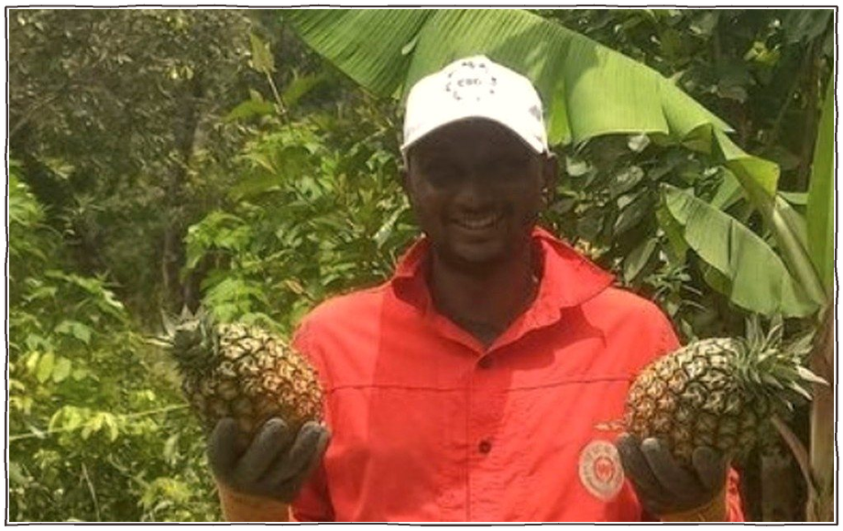
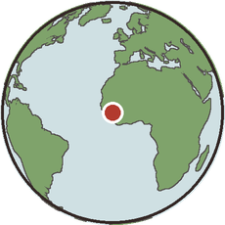
Boubacar, Guinea. Coffee grown in a syntropic agroforest.

Slide 3



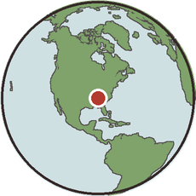
Christina, Tennessee. From advertising to a soil business.
PHOTO: add a photo of Christina from their own post

Slide 4

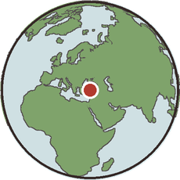
Ibrahim, Turkey. More than 80 growers going regenerative.
PHOTO: add a photo of Ibrahim from their own post

Slide 5

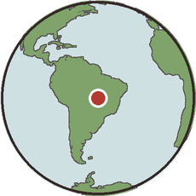
Arthur, Brazil. A prize-winning farm school.
PHOTO: add a photo of Arthur from their own post

Slide 6

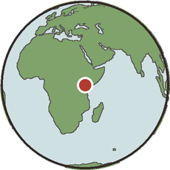
Joseph, Kenya. Teaching his whole community.
PHOTO: add a photo of Joseph from their own post

Slide 7

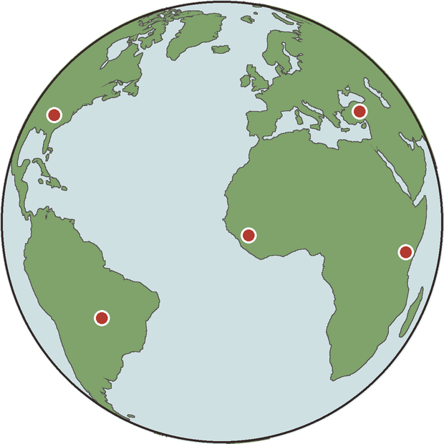
Thank you for protecting the ground we all stand on.

