Slide 1




Myth: “Add 1% organic matter and your soil holds 20,000 more gallons of water per acre.”
the claim everyone repeats

Slide 2


A 2018 review of about 60 studies tested that claim.
Minasny and McBratney, European Journal of Soil Science

Slide 3



A 1% rise in soil organic carbon raised available water only slightly, on average about 1 mm per 10 cm of soil.
what the studies measured
the claim
Drops are not to scale.

Slide 4


The effect was larger in sandy soils and smaller in clays.
sand: more effect
clay: less effect

Slide 5

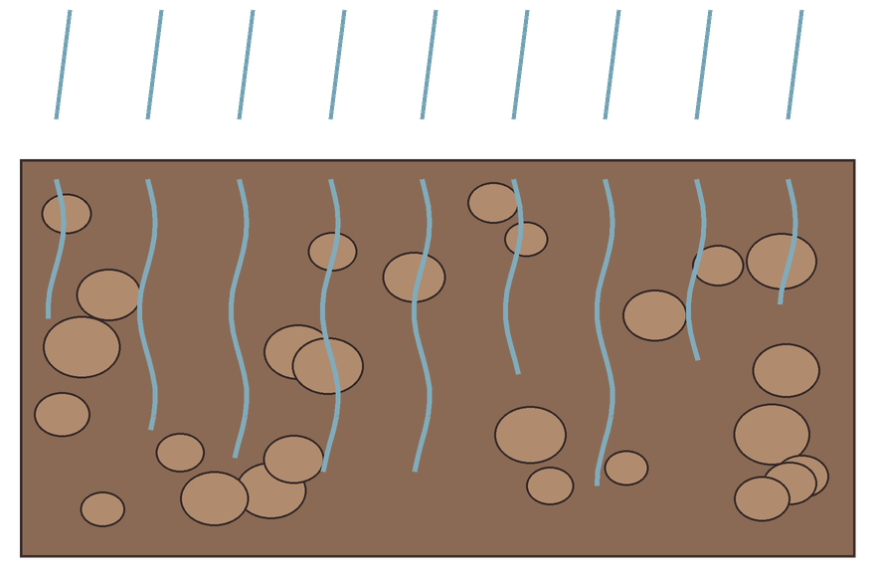
Where biology really helps water: aggregates and pores that let rain soak in instead of running off.
rain soaks in between the crumbs

Slide 6

Honest numbers build trust. Source on the slide.
Minasny, B. and McBratney, A. B. (2018). Limited effect of organic matter on soil available water capacity. European Journal of Soil Science 69: 39–47.

