Slide 1

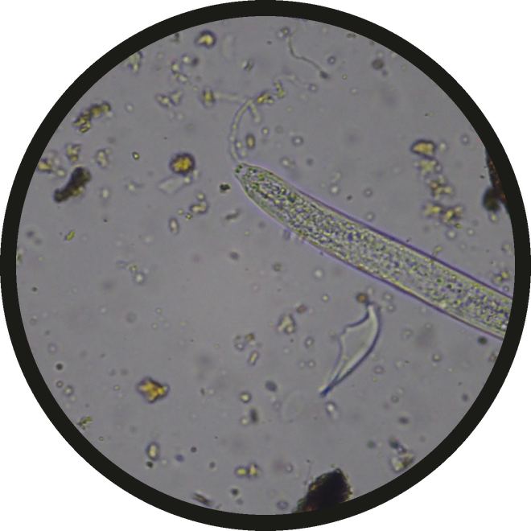

FREE WEBINAR
Micrograph: Casey Williams, 40x objective

Slide 2

[Webinar title]

Slide 3

[Date and time, three time zones]

Slide 4



[Host name]
PHOTO: the host's headshot

Slide 5



Free. Link in bio.

