Slide 1

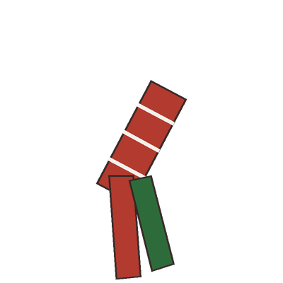


Your worms get cold too.
a red wiggler, ready for winter

Slide 2

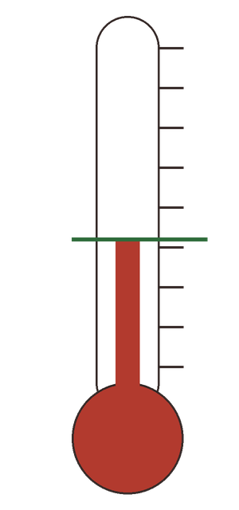


Red wigglers slow down below about 10°C and die if the bin freezes.
about 10°C: worms slow down

Slide 3

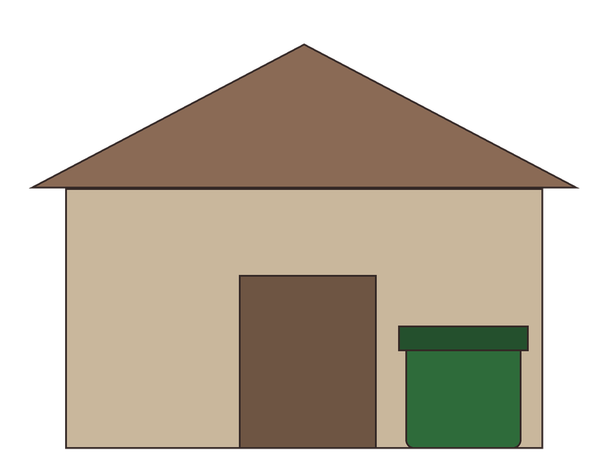

Move the bin to a shed, garage or basement.
the worm bin, out of the frost

Slide 4

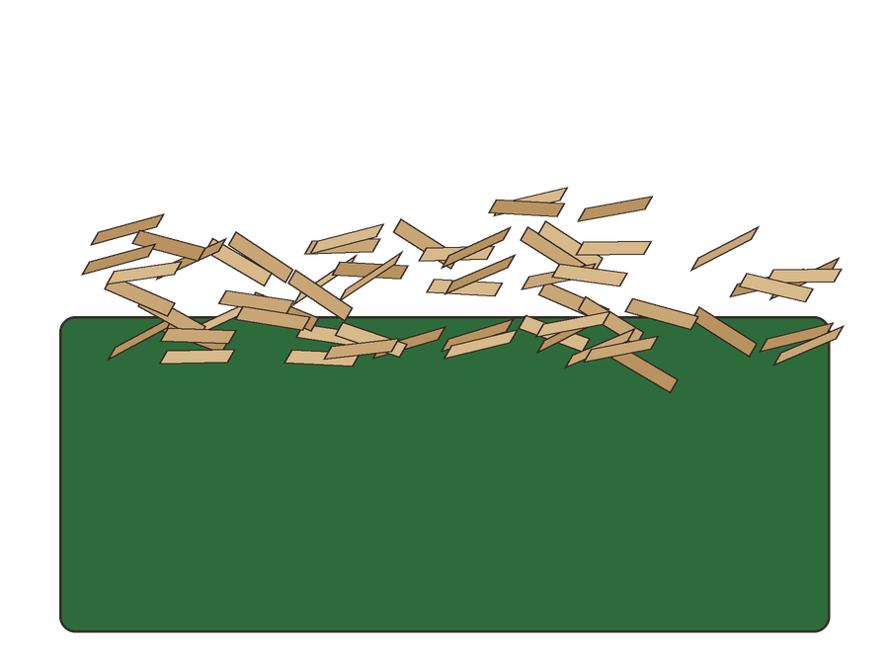
Add extra shredded cardboard as insulation, and feed less.
a thick layer of shredded cardboard

Slide 5

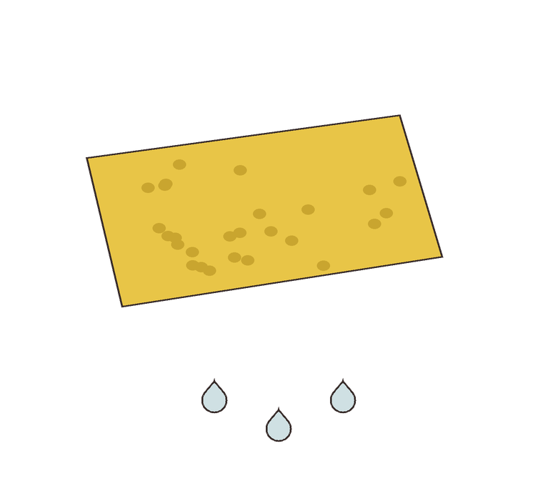

Keep the bedding damp, like a wrung-out sponge.
a few drops, not a stream

