Slide 1

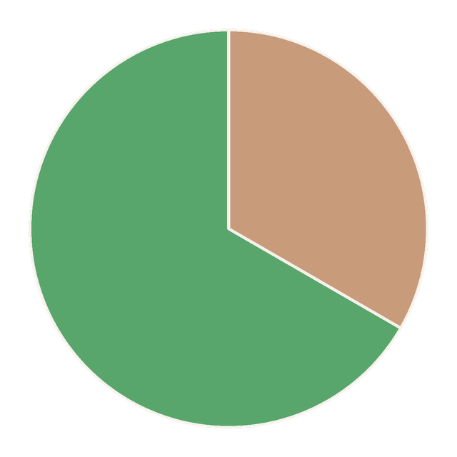


33% of the world's soils are moderately to highly degraded.
one in three
Source: FAO and ITPS (2015), Status of the World's Soil Resources

Slide 2

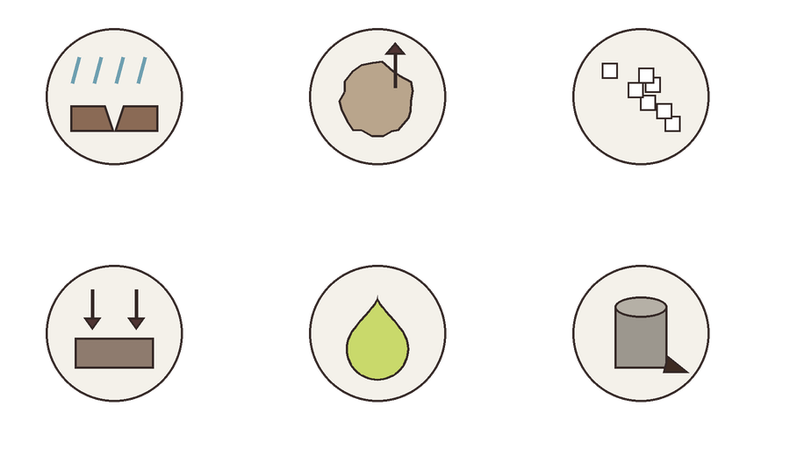
The causes: erosion, loss of organic carbon, salinization, compaction, acidification and pollution.
erosion
carbon loss
salinization
compaction
acidification
pollution

Slide 3

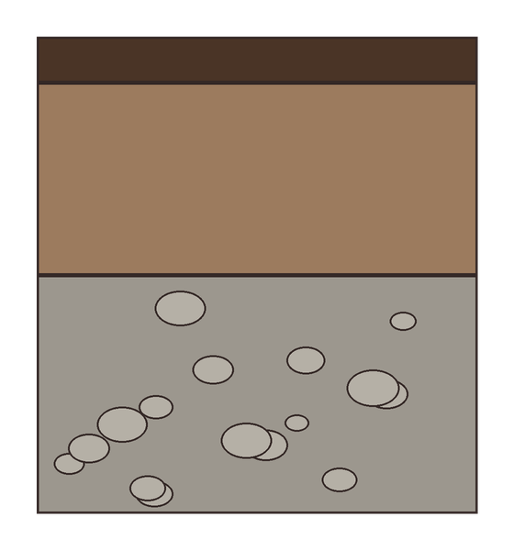

Forming a few centimeters of new soil can take centuries.
a few centimeters of topsoil
rock that weathers slowly

Slide 4

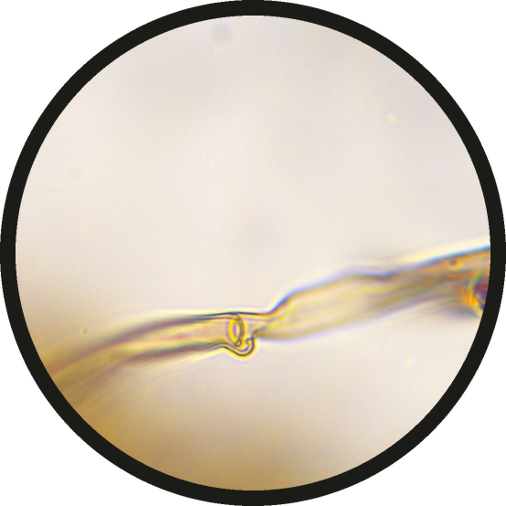
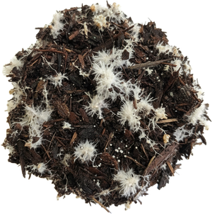
Restoring soil biology is one of the fastest ways to rebuild it.
a fungal hypha at 100x, by Marco Trevisan

