Slide 1

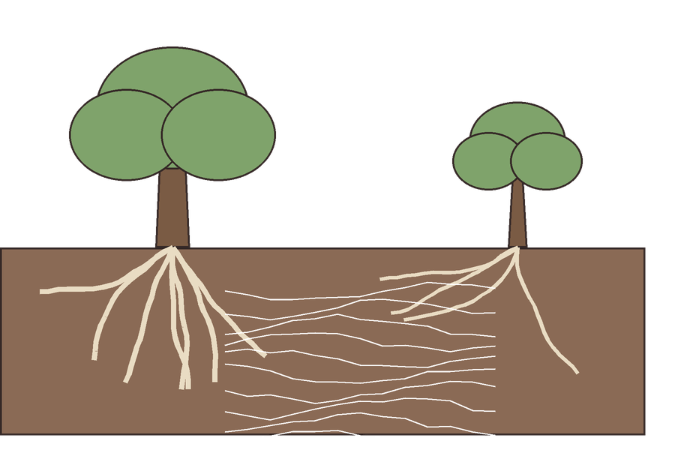
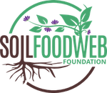
Myth: “Mother trees feed their seedlings through a fungal internet.”

Slide 2


Mycorrhizal fungi do connect the roots of different trees. That part is real.
fungal threads between the roots

Slide 3


But field evidence that trees send meaningful resources to each other through them is thin.

Slide 4

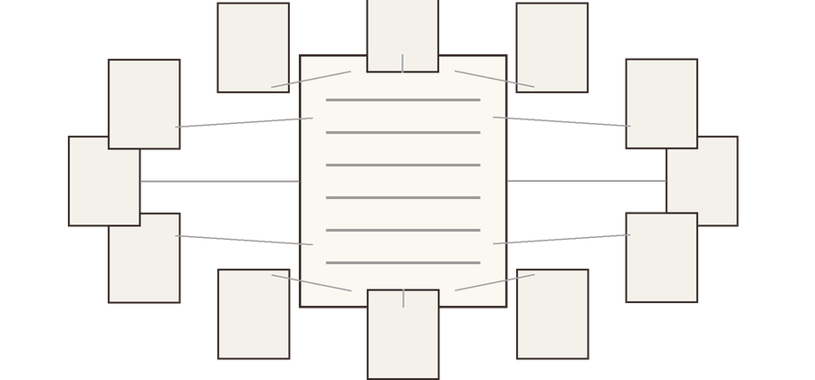
A 2023 review found positive citation bias: papers cited the dramatic claims more than the data supported.
Karst et al. 2023, Nature Ecology and Evolution

Slide 5

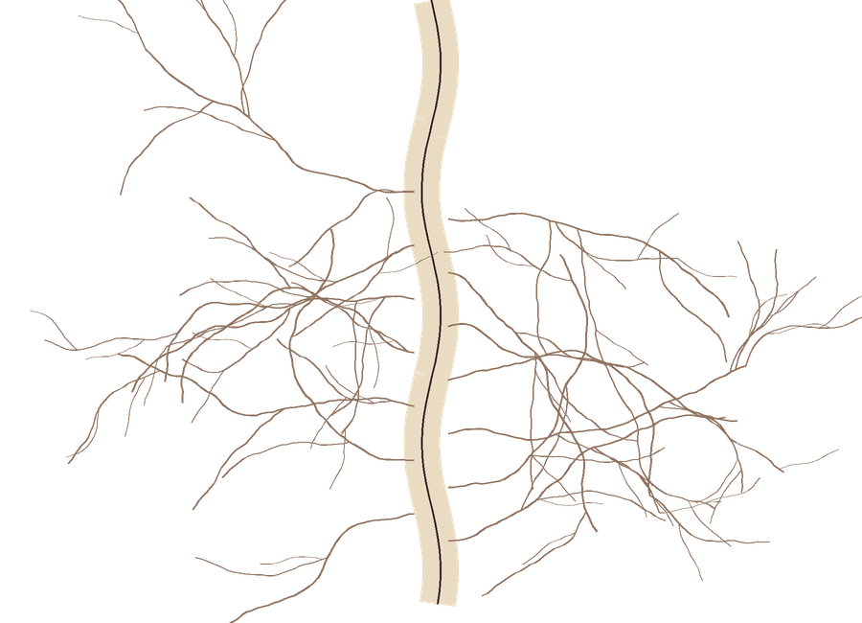


What is solid: mycorrhizal fungi trade nutrients and water for plant sugars, one plant at a time.
sugars go to the fungus
nutrients and water come back

Slide 6

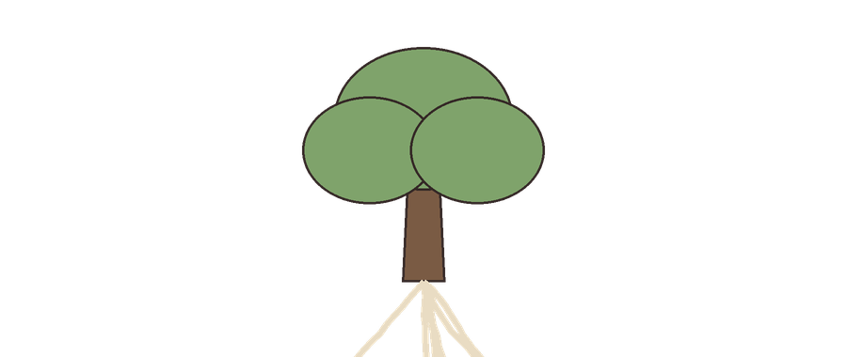
Real science is exciting enough. Source on the slide.
Karst, J., Jones, M. D. and Hoeksema, J. D. (2023). Positive citation bias and overinterpreted results lead to misinformation on common mycorrhizal networks in forests. Nature Ecology and Evolution 7: 501–511.

