Slide 1

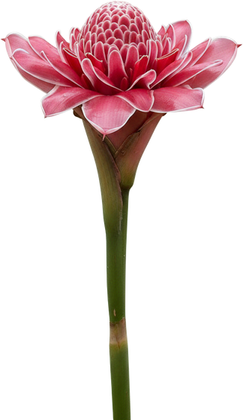
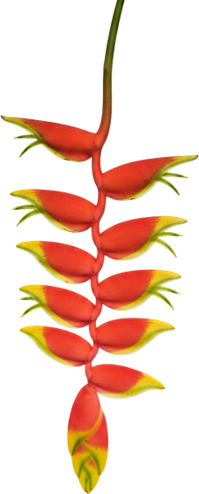


Fun Soil News: December 2026.

Slide 2



FUN SOIL NEWS · DECEMBER 2026
Story 1. Country in big type, one sentence, source.

Slide 3

FUN SOIL NEWS · DECEMBER 2026
Story 2. Country in big type, one sentence, source.

Slide 4


FUN SOIL NEWS · DECEMBER 2026
Story 3. Country in big type, one sentence, source.

Slide 5


FUN SOIL NEWS · DECEMBER 2026
Story 4. Country in big type, one sentence, source.

Slide 6

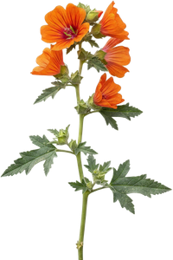
FUN SOIL NEWS · DECEMBER 2026
Story 5. Country in big type, one sentence, source.

