Slide 1



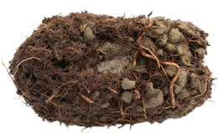

What is your soil made of? Find out with a jar.
a jar, water and a handful of your soil

Slide 2

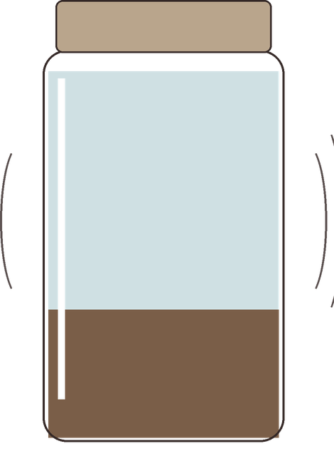



Fill a jar one third with soil, top up with water and a pinch of dish soap. Shake hard.
a pinch of dish soap
water
one third soil

Slide 3

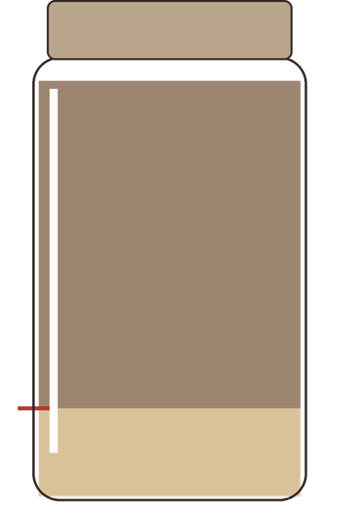


Sand settles in about a minute. Mark the line.
mark the line
sand

Slide 4

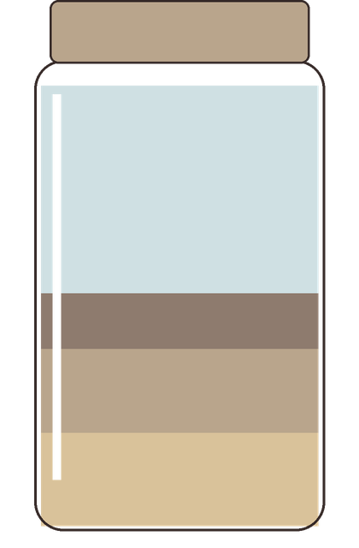
Silt settles over a few hours. Mark it. Clay can take a day or more.
water
clay
silt
sand

Slide 5

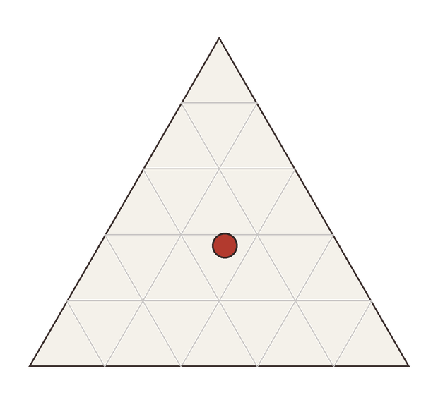
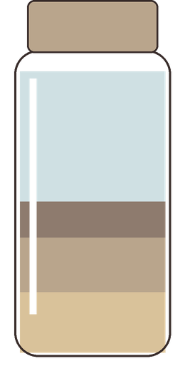

Compare the layers to find your texture.
clay
silt
sand
your soil

