Slide 1

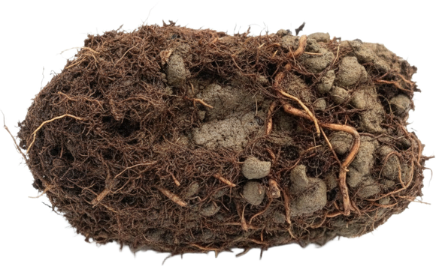



Soil aggregates, explained twice. Level 1 for new gardeners, level 2 for consultants.
Level 1
Level 2

Slide 2

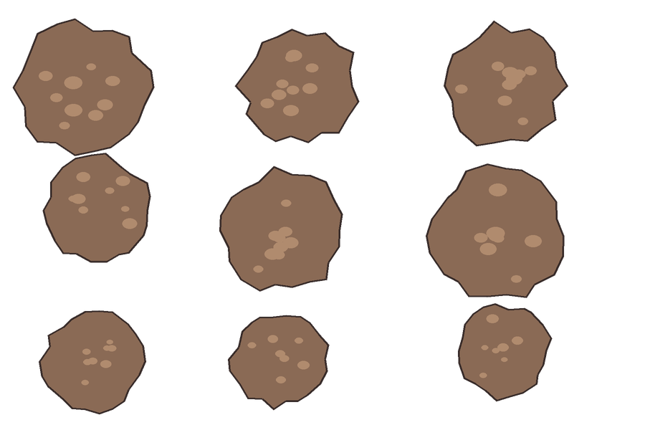

Level 1
Level 1: Healthy soil clumps into crumbs. Those crumbs are aggregates.
one crumb, one aggregate

Slide 3

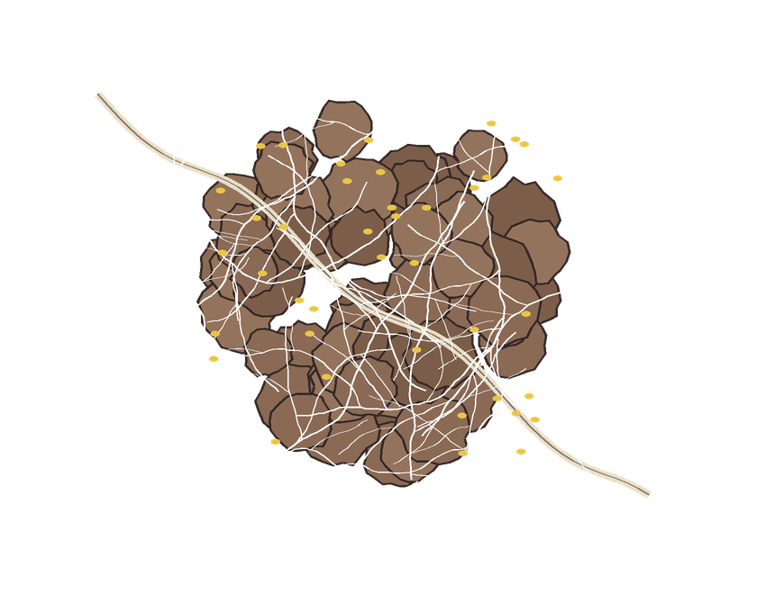


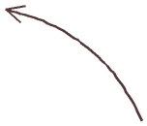
Level 1
Level 1: Roots, fungi and bacteria glue them together.
a root
fungal threads
bacteria

Slide 4

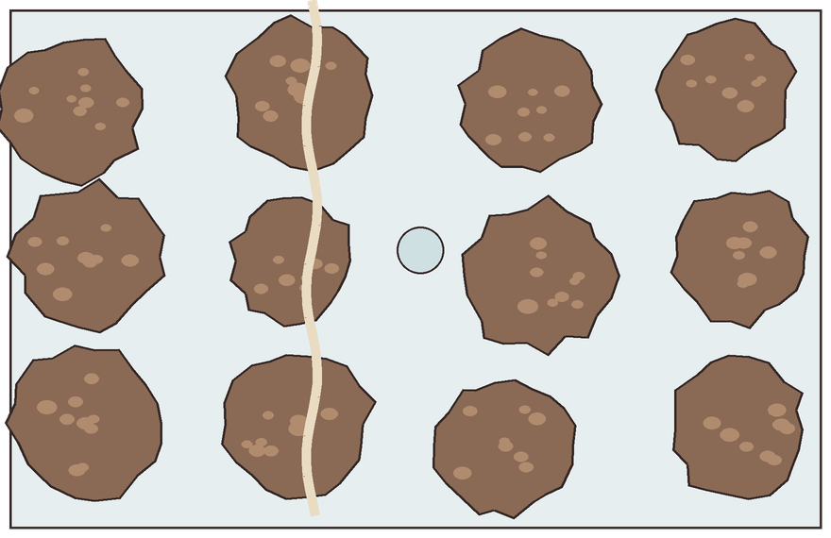



Level 1
Level 1: Crumbs leave spaces for air, water and roots.
air
a root
water

Slide 5

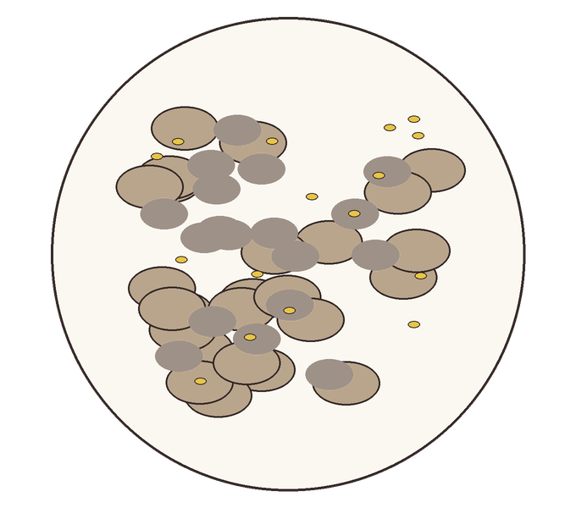

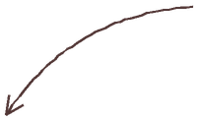
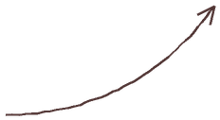
Level 2
Level 2: Microaggregates are bound by persistent organic compounds and bacterial glues.
mineral particles
organic compounds
bacteria and their glues

Slide 6

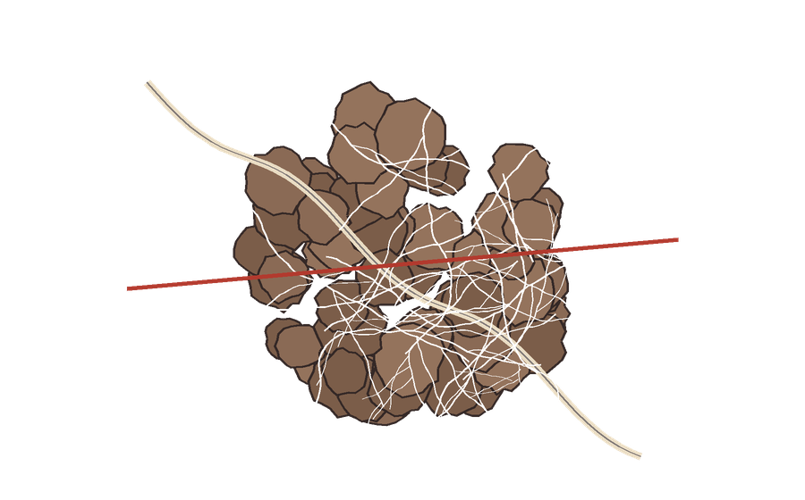

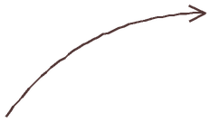
Level 2
Level 2: Macroaggregates are held by roots and fungal hyphae, so they break down when tillage cuts those networks.
made of microaggregates
tillage cuts here

Slide 7

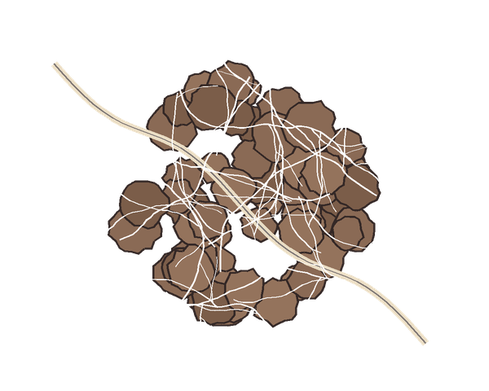
Source: Tisdall and Oades, 1982.
Tisdall, J. M. and Oades, J. M. (1982). Organic matter and water-stable aggregates in soils. Journal of Soil Science 33: 141–163.

