Slide 1




Myth: “Humus is a special, stable substance in soil.”
the textbook picture

Slide 2

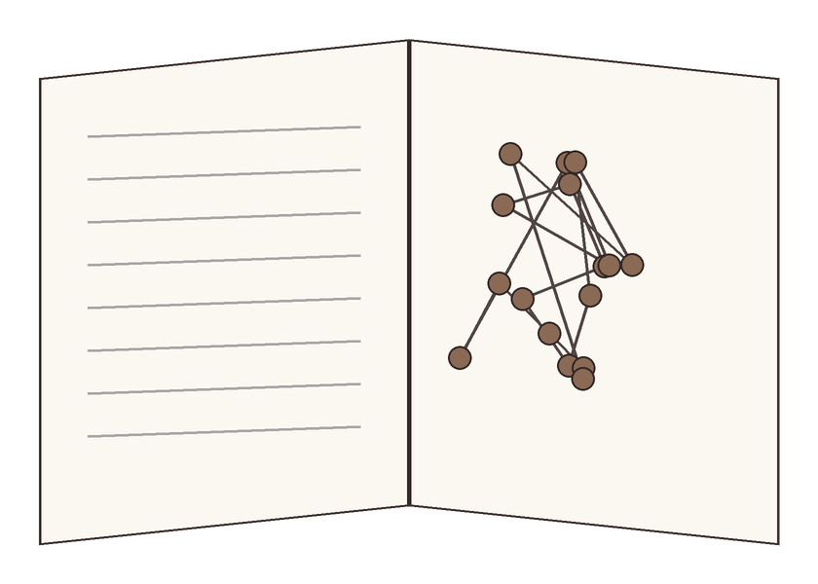
For a century, textbooks described humic substances as large, unique molecules.
a giant “humic molecule”

Slide 3

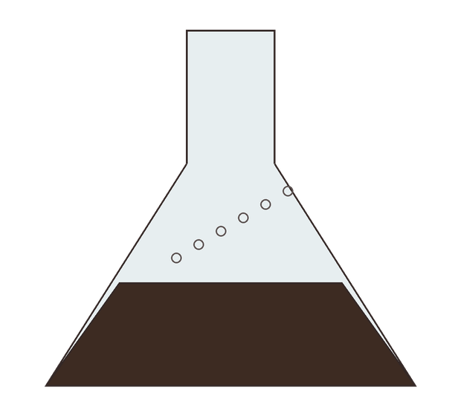

Modern imaging found little of that in intact soil. Much of it came from the harsh extraction method.
strong alkali pulls out dark extracts

Slide 4

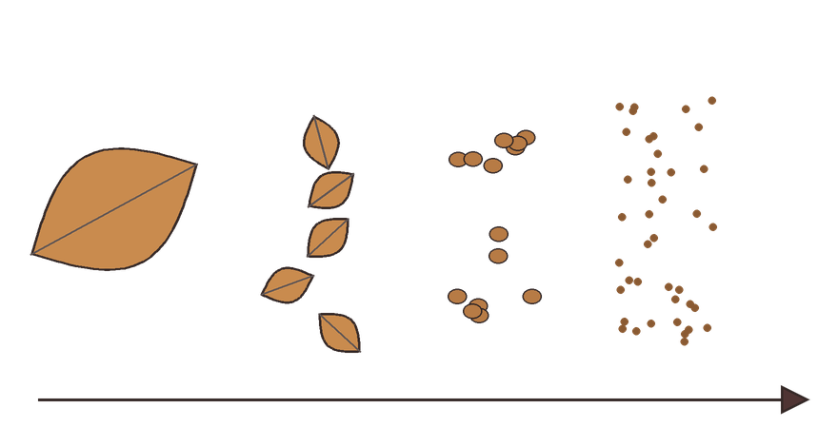
The current view: organic matter is a continuum of compounds being broken down by microbes.
a leaf
smaller and smaller pieces, eaten by microbes

Slide 5

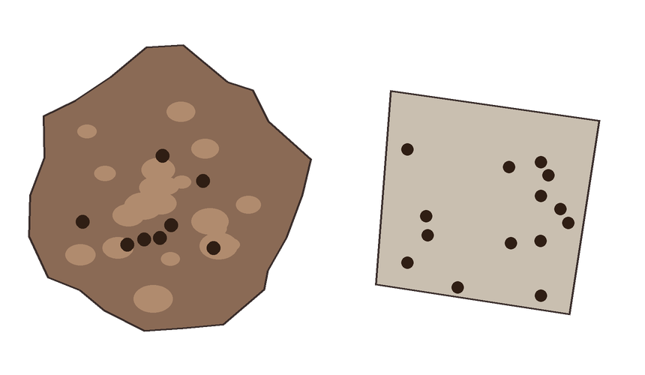
Carbon stays in soil mainly when it's protected in aggregates or bound to minerals.
stuck to a mineral surface
inside an aggregate

Slide 6

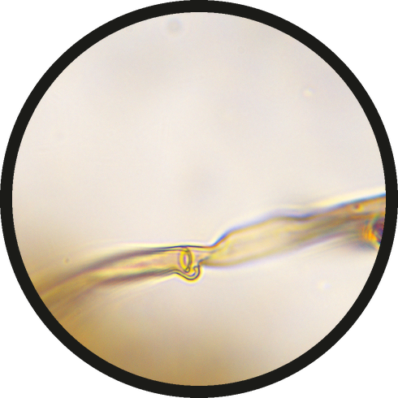

Microbes are part of the answer. Source on the slide.
Lehmann, J. and Kleber, M. (2015). The contentious nature of soil organic matter. Nature 528: 60–68.
a fungal hypha at 100x, by Marco Trevisan

