Slide 1

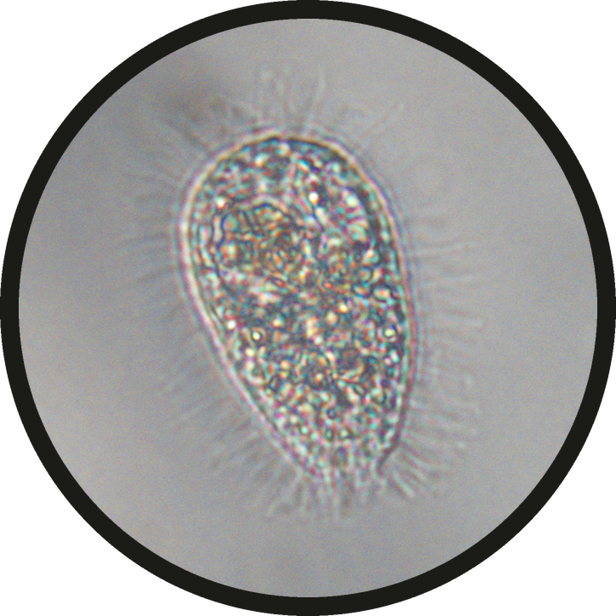


This is a ciliate.
a ciliate, seen at 60x
Micrograph: Patricia J Coppola, 60x objective

Slide 2

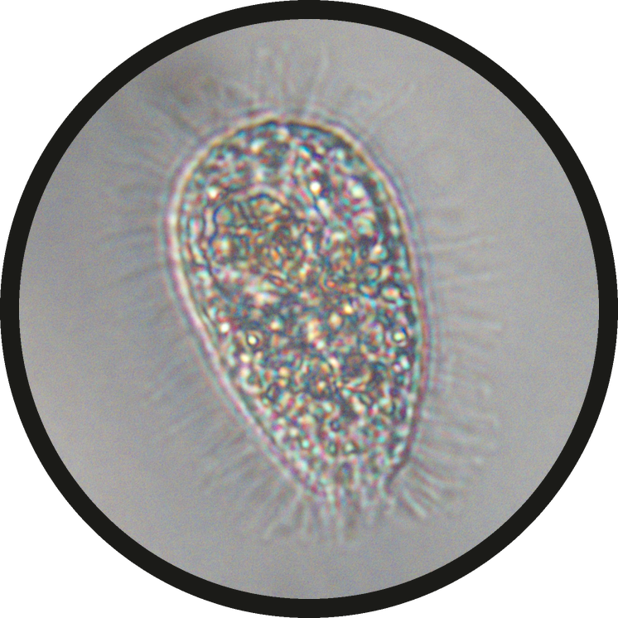


Hair-like cilia cover its body.
cilia
cilia

Slide 3

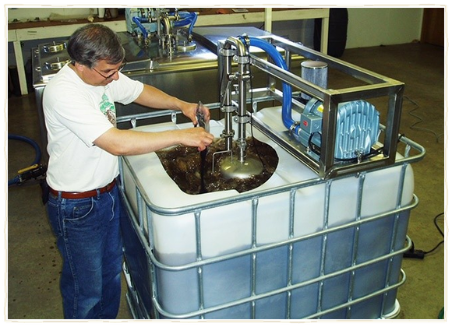
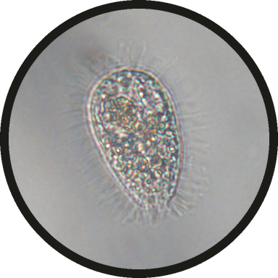

Lots of them in compost or tea?
compost tea brewing
one ciliate is normal, a slide full is a warning

Slide 4

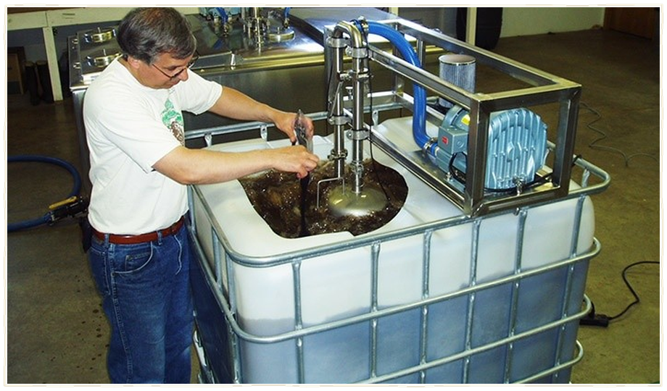
Oxygen has run low. Fix it before you apply.
aerate the brew, turn the pile, add structure

