Slide 1

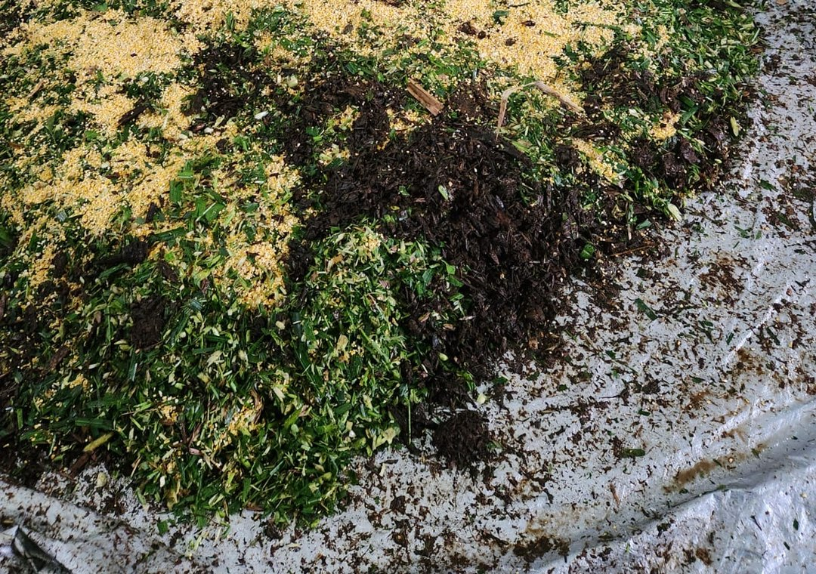

Foundation Courses + Compost Intensive
Fall Enrollment Special, until 2 December.

Slide 2


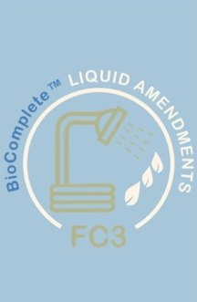
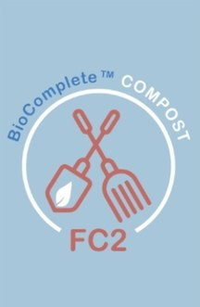


4 Foundation Courses
Introduction to the Soil Food Web, BioComplete™ Compost, BioComplete™ Liquid Amendments and Microscopy. Self-paced, online.

Slide 3

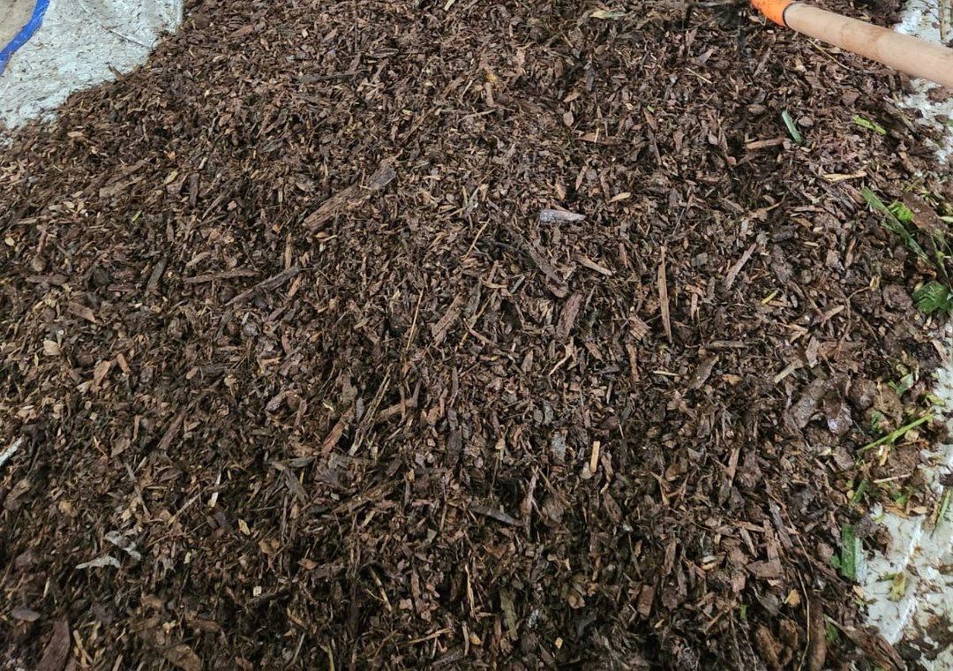
Compost Intensive Course
10 weeks online. Build 2 compost piles at home, with a weekly live call.

Slide 4


Choose your cohort
Compost Intensive cohorts in 2027:
January
May
August

Slide 5

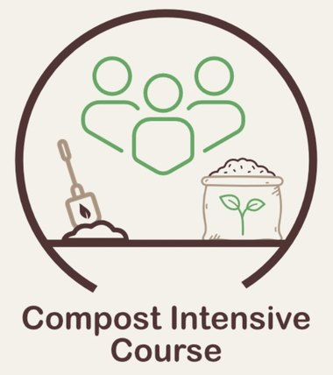
FALL ENROLLMENT SPECIAL
Until 2 December
Foundation Courses + Compost Intensive bundle. Link in bio.

