Slide 1
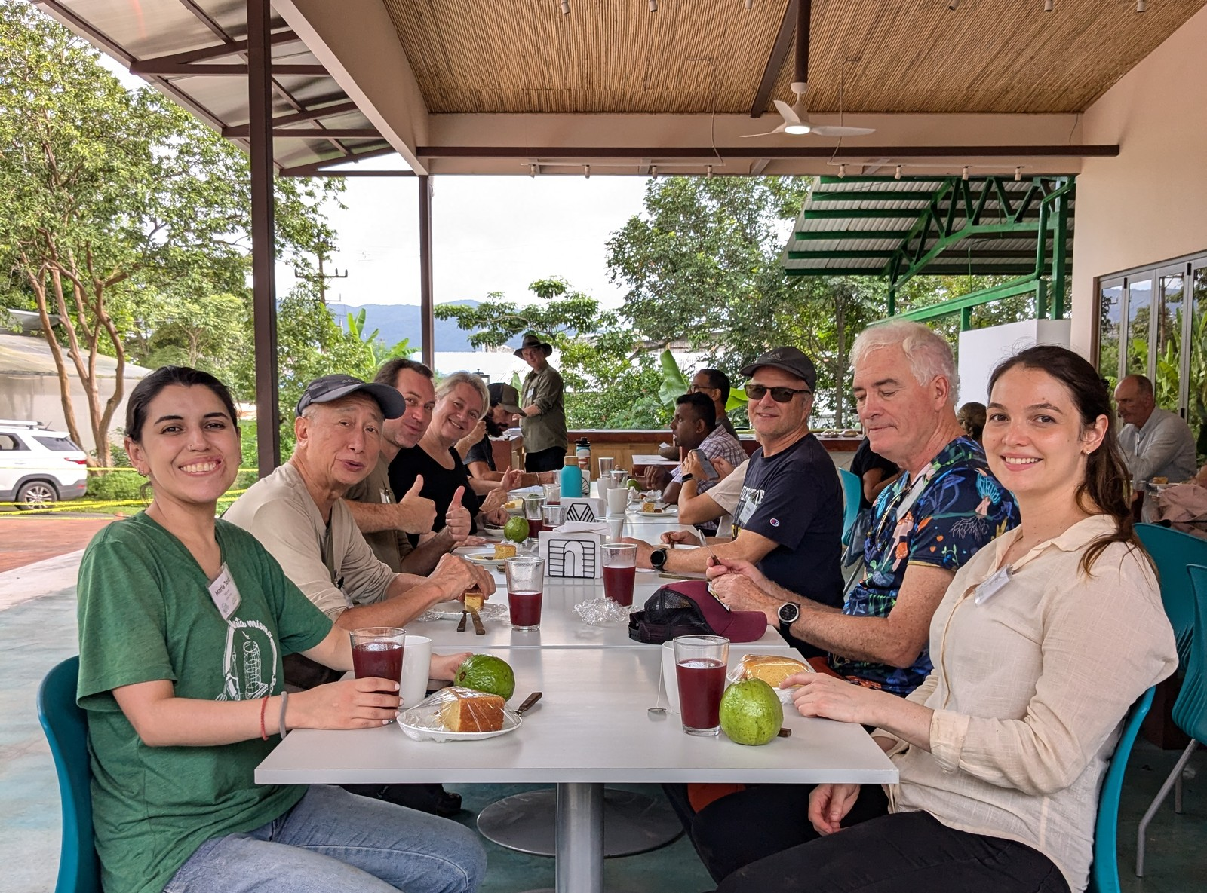


A day at the Costa Rica workshop.
Accelerator Workshop, Costa Rica · 18 to 29 January 2027

Slide 2
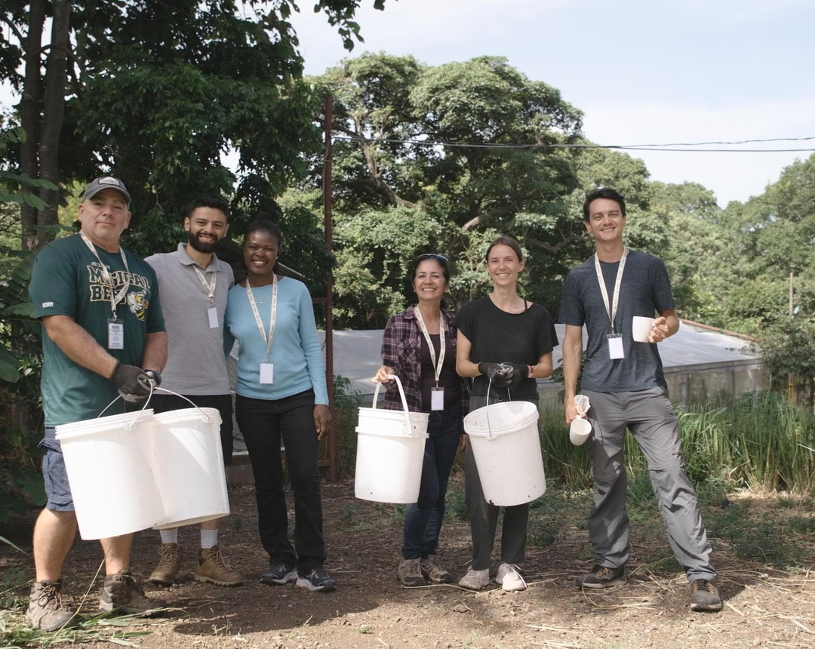


Morning: build the pile.
Feedstocks, water, and a team to turn it with.

Slide 3


Midday: lunch together.
Lunch is on site, Monday to Friday.

Slide 4
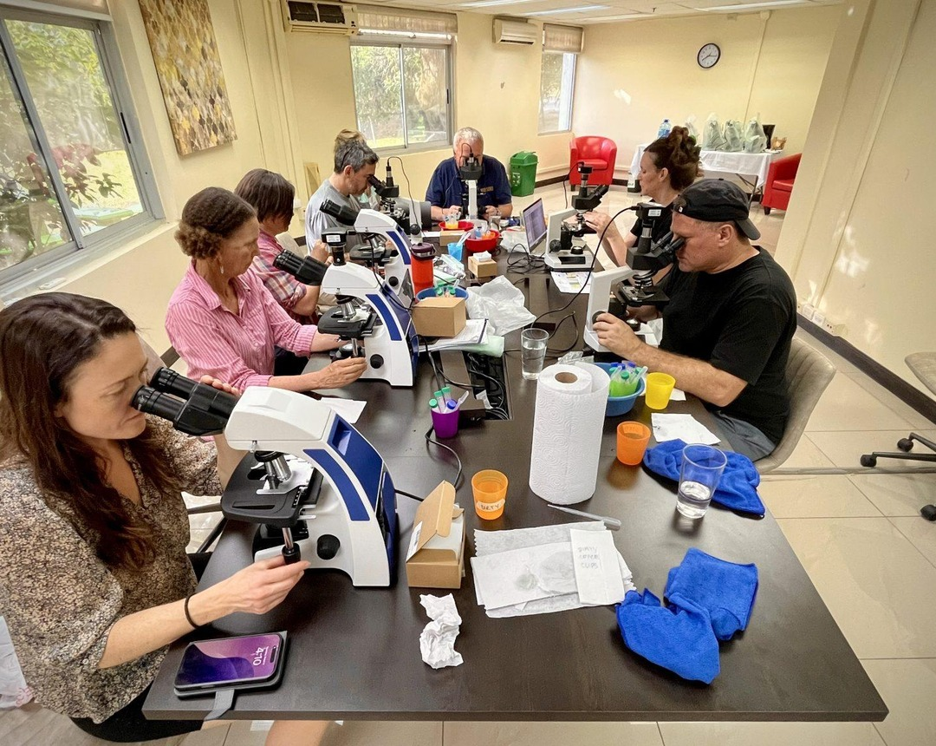
Afternoon: the microscope.
You check what you made in the morning.

Slide 5

18 to 29 January 2027
Accelerator Workshop at Armonía Agricultura Orgánica, near San José, Costa Rica
Register, link in bio

