Slide 1
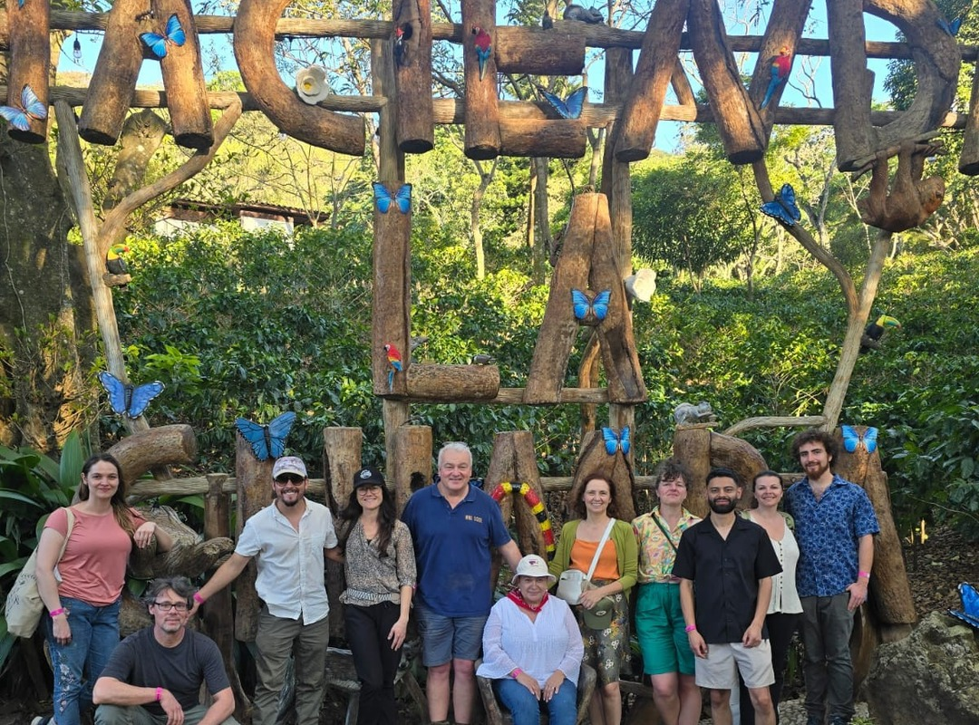
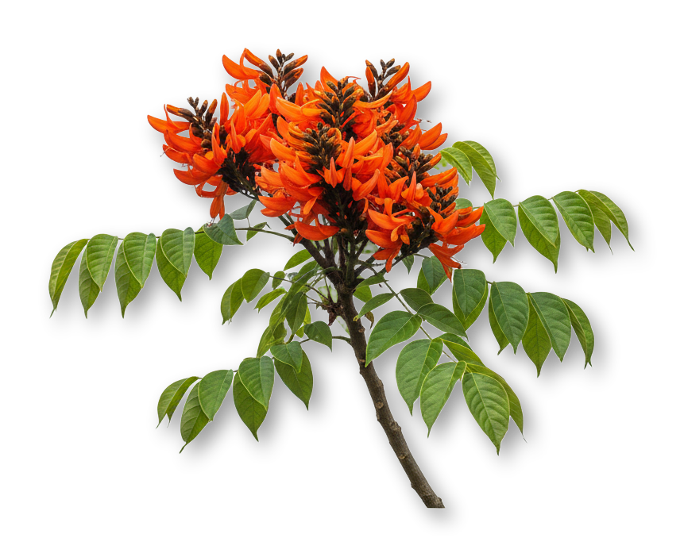

Costa Rica brought its forests back.
Why we teach here

Slide 2



FOREST COVER IN COSTA RICA
21–25%
53%
in the 1980s
by 2016
Source: Inter Press Service, 2016

Slide 3

Its farms carry some of the heaviest chemical loads in the world.
Pesticide and fertilizer use per hectare is among the highest on Earth.
Sources: FAO data via Semanario Universidad, 2023; World Bank

Slide 4
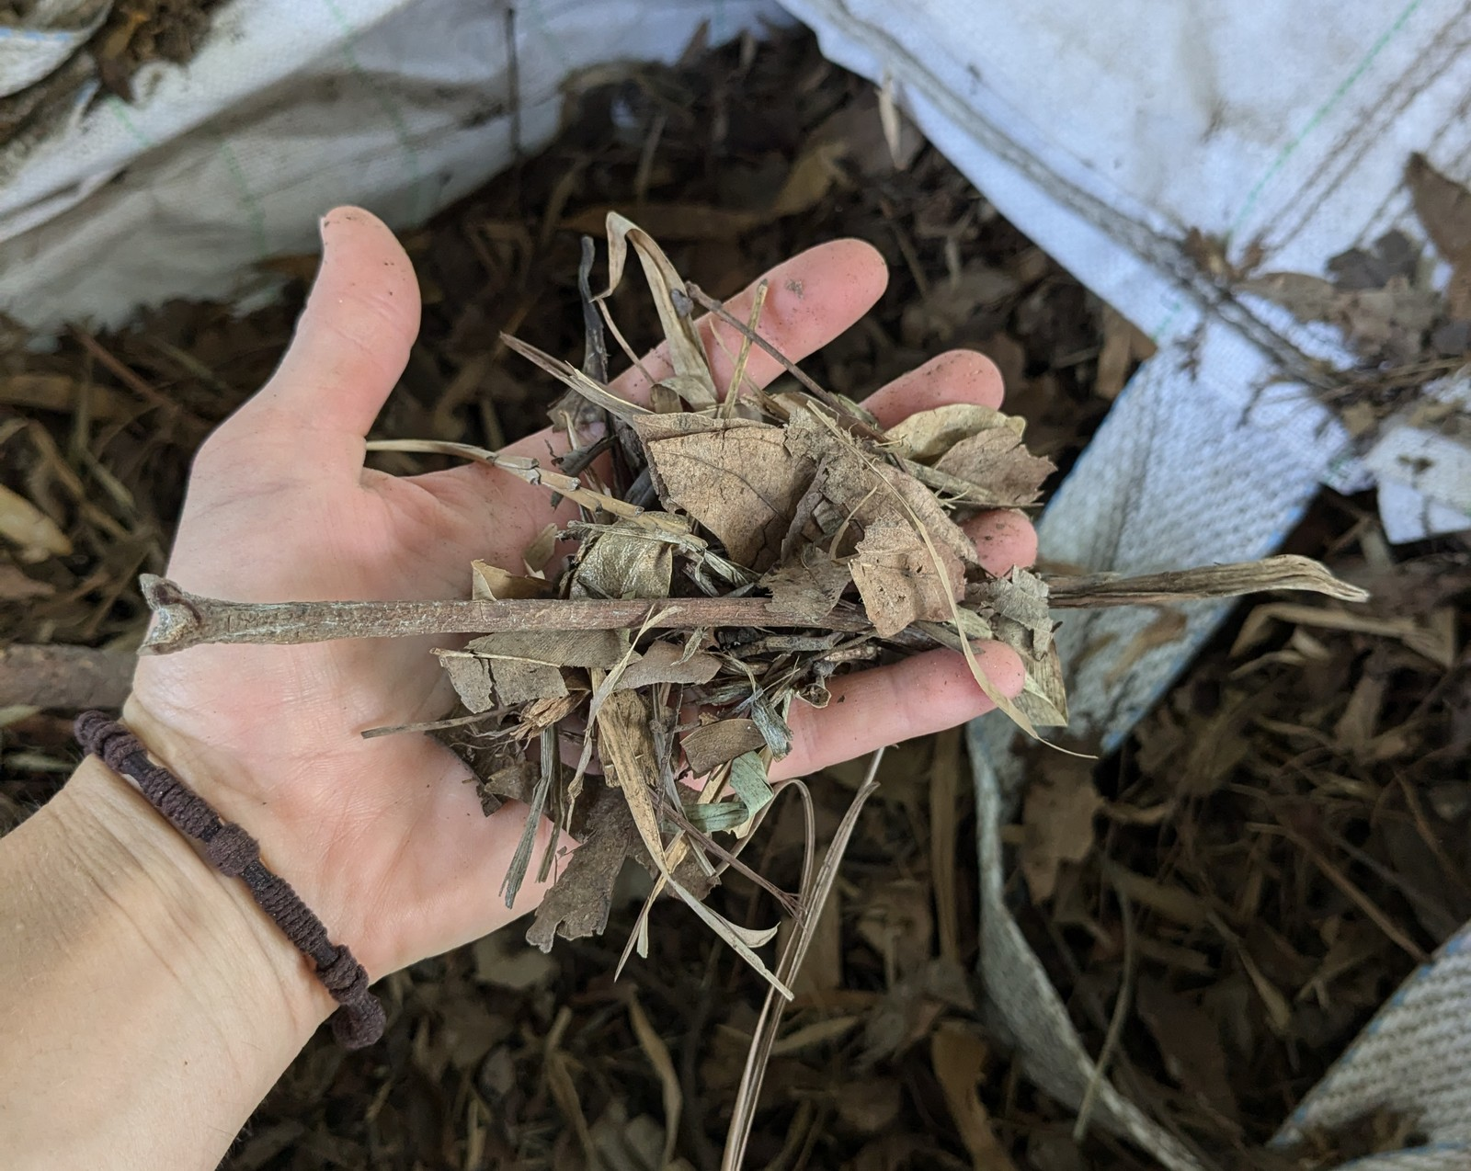
Our students learn to build living soil from local materials.
And they take it home.

Slide 5

18 to 29 January 2027
Accelerator Workshop at Armonía Agricultura Orgánica, near San José, Costa Rica
Register, link in bio

